Slide 1

Virginia Course Materials Survey 2021
Initial results, limited to two Year institution students, April 1, 2022
A summary report is forthcoming in summer 2022

Slide 2
“It’s wildly stressful at times to decide whether to buy an access code, textbook, lab workbook, etc or put gas in your car.”
- Two year institution Student respondent

Slide 3
Virginia Course Materials Survey
Conducted from October 1-December 31, 2021
More than 5,600 valid student responses from 41 institutions were received, reflecting an overall response rate of 10%.
Overarching research questions of the survey:
  What is the impact of course material costs on educational equity among Virginia students?
  What course content materials do students find to be most beneficial to their learning?
The full survey instrument is available here: https://vivalib.org/va/open/survey.

Slide 4
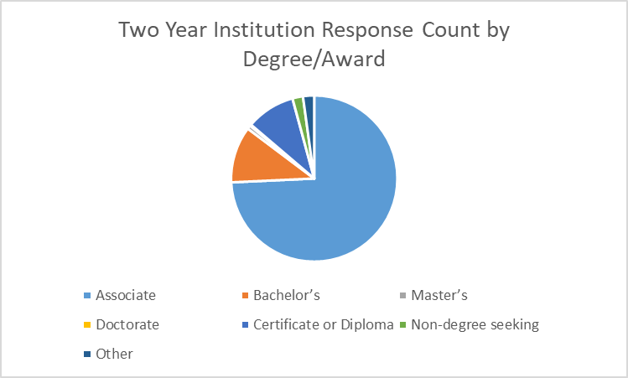
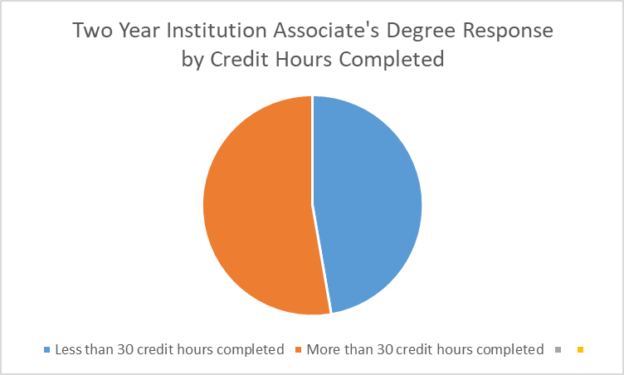
Two Year Institutions Focus
The results in this presentation are limited to the 829 two year institution students who took this survey. The students were from the following institutions:
Blue Ridge Community College
Central Virginia Community College
Dabney S. Lancaster Community College
Germanna Community College
J Sargeant Reynolds Community College
John Tyler Community College
Lord Fairfax Community College
Paul D Camp Community College
Rappahannock Community College
Southwest Virginia Community College
Tidewater Community College
Thomas Nelson Community College
Virginia Highlands Community College
Virginia Western Community College

Slide 5
Examining the Impact on Students

Slide 6
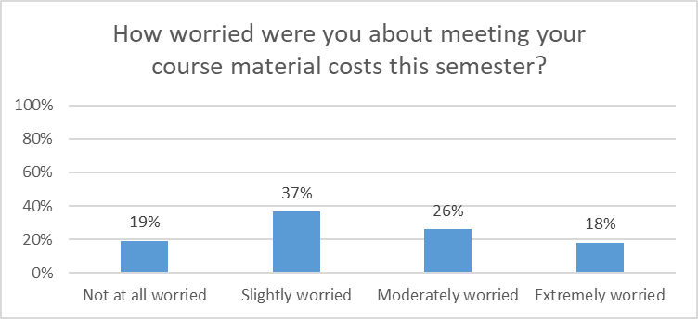
Worry about Course Material Costs
81% of all two year institution student respondents had some level of worry, including 18% who were “Extremely Worried,” about meeting their course material costs.

Slide 7
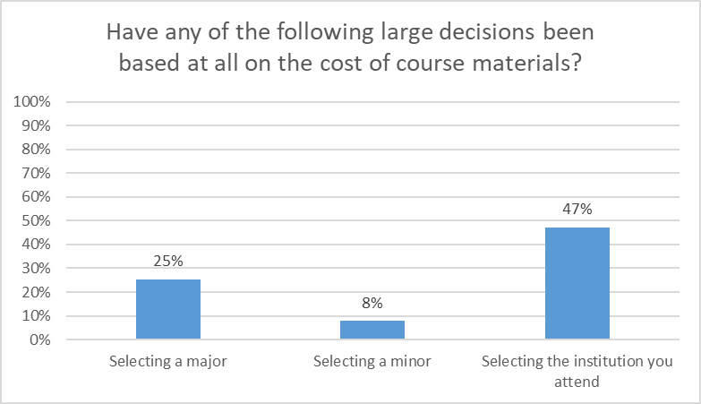
Impact on Large Decisions
“Programs such as the Paramedic & Nursing programs have books that you need to BUY, not rent, for over $1000 by the first semester. Most classes now require Pearson codes, too, so you can't rent textbooks at a more affordable rate because you have to spend $100+ on an access code anyway.”
“The cost of materials decides whether or not I attend higher education.”
Course material costs were a factor for many two year institution students in large decisions, particularly major and institution selection.

Slide 8
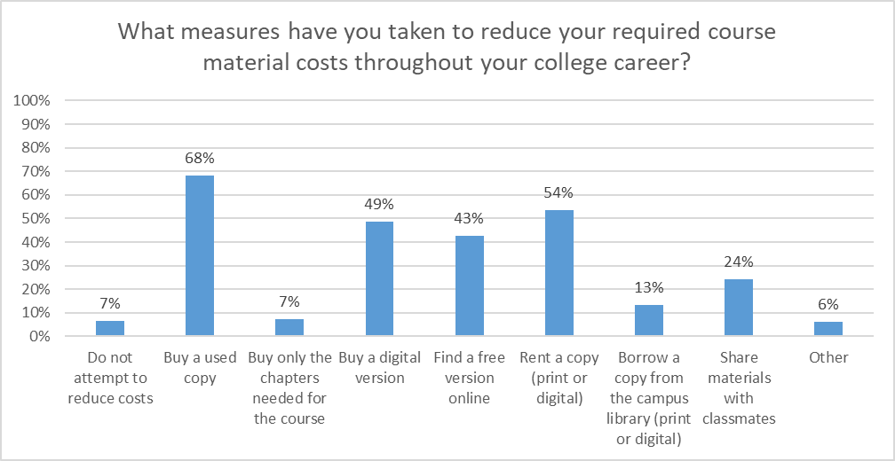
Measures to Reduce Costs
Only 7% of two year institution students do not attempt to reduce their course material costs, with the most common approaches being buying used copies and renting a copy.

Slide 9
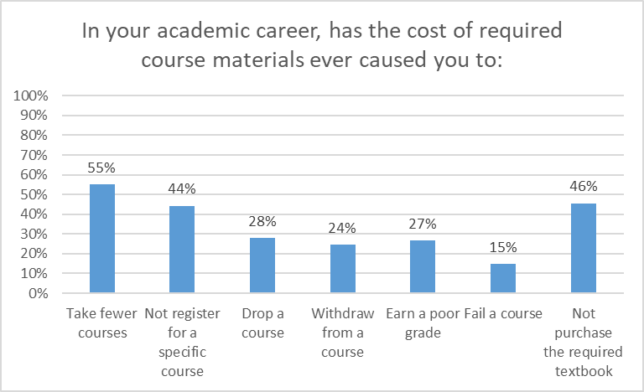
Academic Career Impact
The results show the deep impact of course material costs on Virginia two year institution students’ academic careers, from progress (55% have taken fewer courses, 28% have dropped courses, and 24% have withdrawn from courses) to opportunity (44% have not registered for a specific course) to success (27% have earned a poor grade and 15% have failed a course).

Slide 10
Course-Level Impact
“I was going to take 3 courses this semester. One of the courses I had to purchase 2 textbooks. Just one of the books was $195.00. I'm a non-traditional student who receives little to no financial aid so I dropped the course.”
“The cost for access codes is ridiculous! And it’s not possible to look around for cheaper since it can only be purchased at the bookstore. I’ve had to miss an assignment waiting for a pay day to purchase an access code. ”
“I am more likely to experience financial turmoil in instances where the class requires an access code as these can not be borrowed or rented. I’ve been attending classes here and there for the last 8 or so years with a large break between the first few years and the present. The prevalence of access codes has boomed in the last 4 years in comparison to when I took my first class 8 years ago. The heavy use of access codes has made resources such as second hand book stores almost obsolete.”
“I wanted to take an accounting course but the cost of the materials was a little extreme, so I chose a course that was less expensive.”
Two year institution students described course by course decisions based on course material costs, often mentioning the challenge of homework programs/access codes.

Slide 11
Broad Impact
“Didn’t feel like I could provide for my family or continue my education because I had to choose between food and a roof over our head or a textbook.”
“I live paycheck to paycheck. I have no money left over for extra costs. The cost of books doesn't work into my budget.”
“The shame and guilt of struggling in a class when the materials cost so much money has been hard to escape.”
“It is tiring to having to think about the cost of books when I already have to think about classes.”
Two year institution students also mentioned the impact of course material costs on their life and wellness.

Slide 12
Examining Educational Equity

Slide 13
Identified Areas of Concern
The Survey Task Force identified seven demographic areas of particular concern:
Funding Sources (percentages are specific to two year institution students):
54% are using the Pell Grant Program to fund their education
14% are using Education Loans to fund their education
30% are using Full Time Job(s) to fund their education
Social Aspects (percentages are specific to two year institution students):
37% selected a race/ethnicity other than or in addition to White (defined here as Non White-Only)
50% identify as First Generation students
48% are currently taking care of children, parents, or other family members
10% identified as having a Disability, and over half of these said that their disability affects how they use course materials

Slide 14
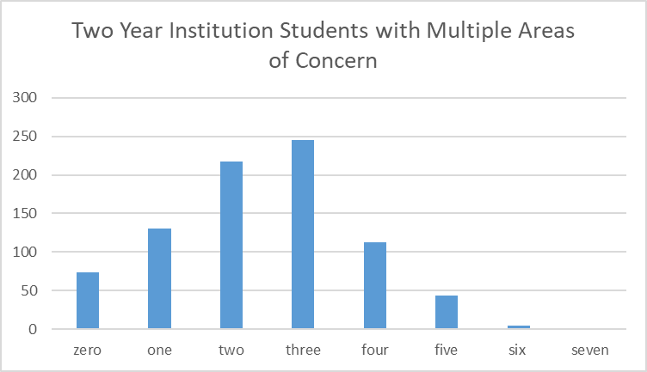
Populations of Concern
The number of areas of concern an individual student had was tracked to see if there were patterns in responses.

Slide 15
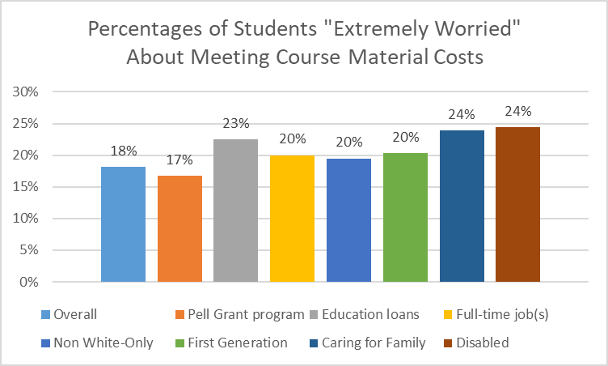
Worry about Course Material Costs
All but one of the areas of concern had higher proportions of two year institution students who were “Extremely worried” about meeting their course materials costs than the overall group.

Slide 16
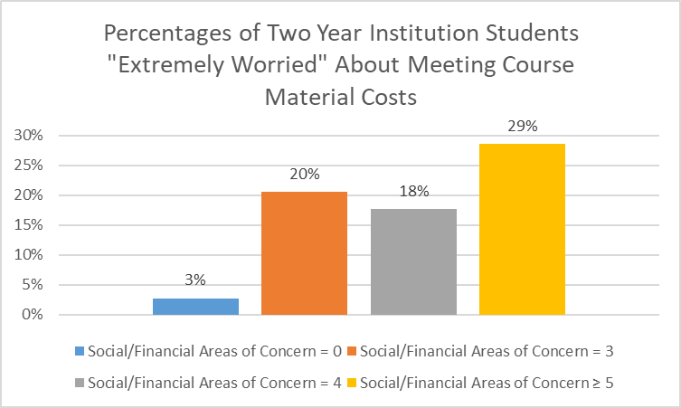
Worry about Course Material Costs
The effect on two year institution student worry generally grew with increasing numbers of the seven areas of concern identified. A First Generation, disabled student using Pell Grant funding, for example, would be more likely to be “Extremely Worried” about meeting course material costs than a student without any of the areas.

Slide 17
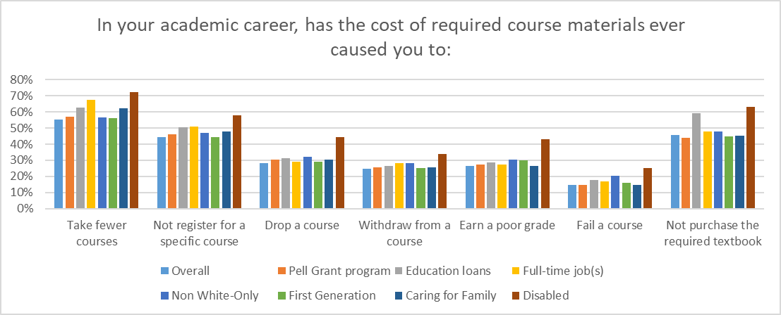
Academic Career Impact
Two year institution students in the areas of concern often showed higher percentages dealing with academic career challenges from the cost of required course materials than the overall population.

Slide 18
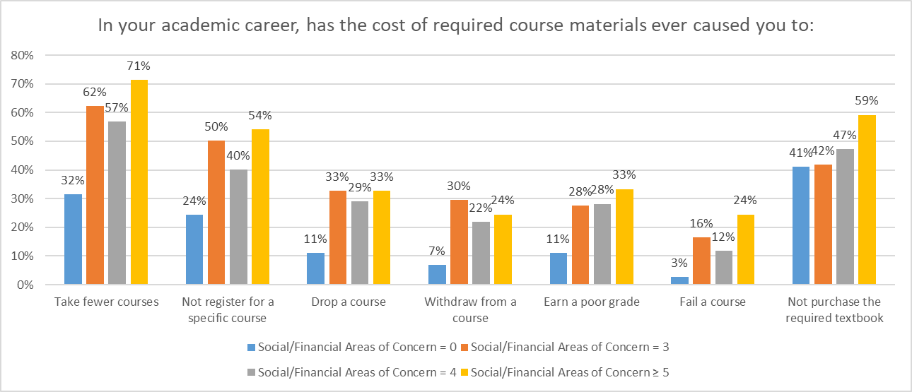
Academic Career Impact
The effect on academic career challenges for two year institution students grew with increasing numbers of the seven areas of concern identified.

Slide 19
Examining Course Materials

Slide 20
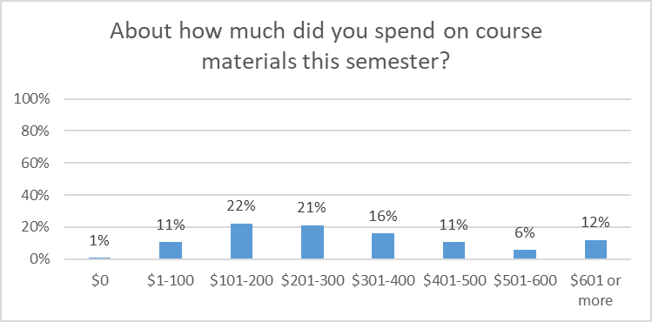
Course Materials Expenditures
Around half of the two year institution students noted that they had spent between $1 and $300 on course materials this semester; around a third had spent between $301 and 600; and 12% had spent more than $601.

Slide 21
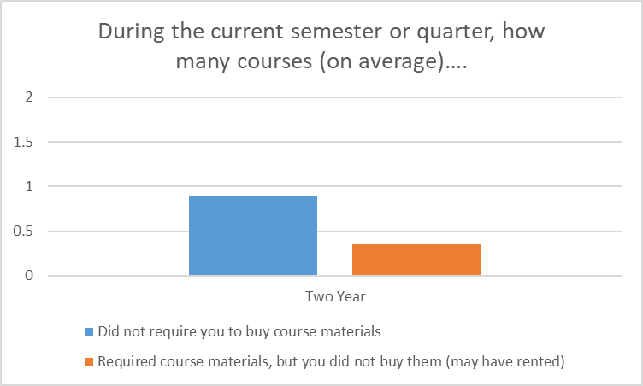
Required Materials
Two year institution students reported that, on average, around 0.9 courses in the current semester or quarter did not require them to buy course materials. As a group, they did not buy required course materials for an average of 0.4 courses, although they may have rented them.

Slide 22
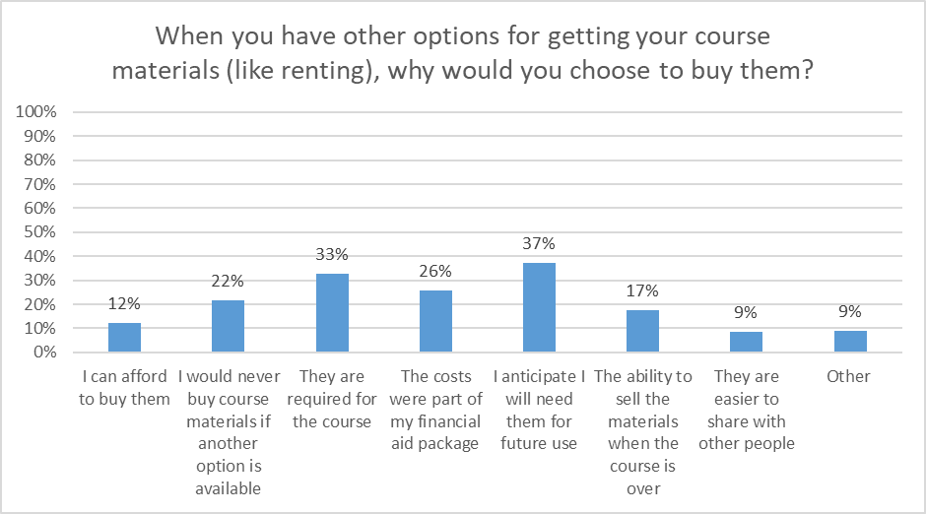
Course Materials Value
The most commonly cited reason to buy (rather than rent) course materials was anticipation of future use. If future use is an important consideration for Virginia students, there may be issues when students only have access to course materials for a limited time, such as through access codes.

Slide 23
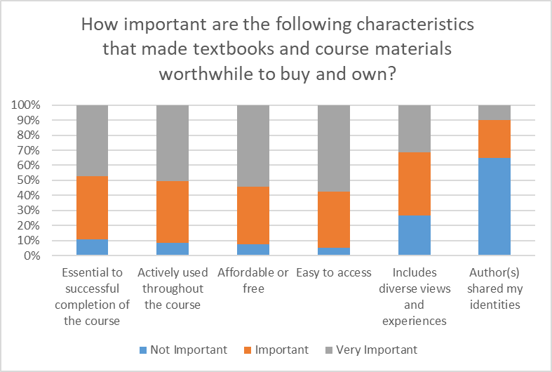
Course Materials Value
The most important characteristics that made course materials worthwhile to buy and own for students at two year institutions were that they were affordable/free, easy to access, actively used throughout the course, and essential to successful completion of the course.

Slide 24
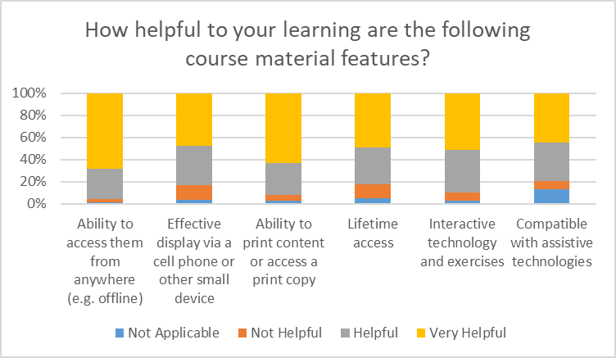
Course Materials Value
The most helpful aspects of course materials for students from two year institutions were the ability to access them from anywhere (e.g. offline), the ability to obtain a print version, and interactive technology and exercises.

Slide 25
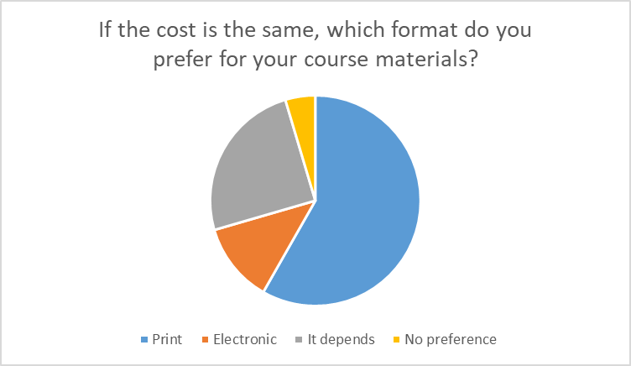
Print vs. Electronic
More than half (almost 60%) of two year institution respondents preferred the print format for course materials, and around a quarter said that it depends.

Slide 26
Next Steps
This is intended to be a soft release of initial findings so that institutions can begin to discuss the local and statewide implications of the results.
A summary report is planned for Summer 2022.
If you have any questions, please contact viva@gmu.edu.

