Slide 1

Virginia Course Materials Survey 2021
Initial results, limited to private institution students, April 1, 2022
A summary report is forthcoming in summer 2022

Slide 2
“The books were often too expensive so I frequently had to use the internet to find answers to my questions I needed instead of reading through the book. I felt lost or a little misguided in many classes because I wasn't reading through the book like the rest of the class was.”
- Private institution Student respondent

Slide 3
Virginia Course Materials Survey
Conducted from October 1-December 31, 2021
More than 5,600 valid student responses from 41 institutions were received, reflecting an overall response rate of 10%.
Overarching research questions of the survey:
  What is the impact of course material costs on educational equity among Virginia students?
  What course content materials do students find to be most beneficial to their learning?
The full survey instrument is available here: https://vivalib.org/va/open/survey.

Slide 4
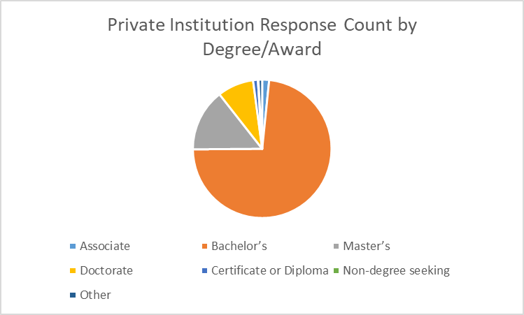
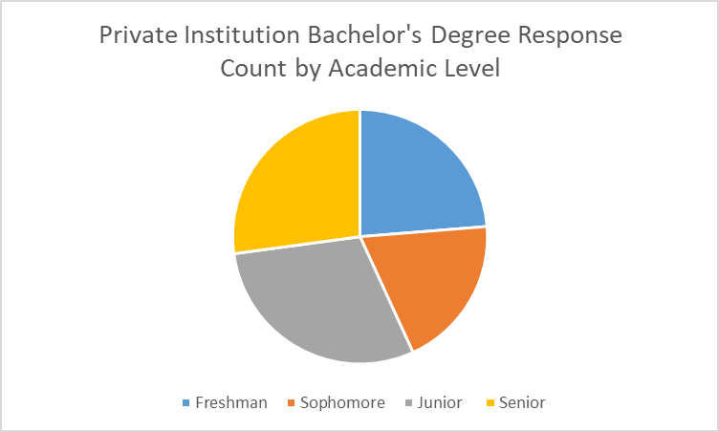
Private Institutions Focus
The results in this presentation are limited to the 804 private institution students who took this survey. The students were from the following institutions:
Appalachian School of Law
Bridgewater College
Emory & Henry College
Eastern Mennonite University
Ferrum College
Hollins University
Hampden-Sydney College
Liberty University
Mary Baldwin University
Randolph College
Randolph-Macon College
Roanoke College
Sweet Briar College
Shenandoah University
Virginia Union University
Virginia Wesleyan University

Slide 5
Examining the Impact on Students

Slide 6
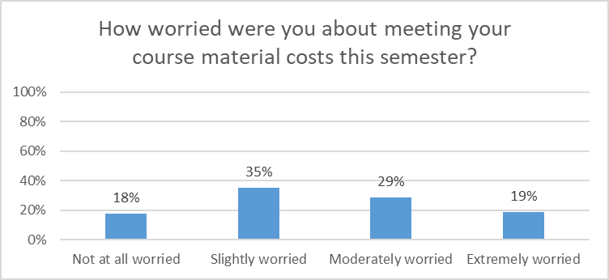
Worry about Course Material Costs
83% of all private institution student respondents had some level of worry, including 19% who were “Extremely Worried,” about meeting their course material costs.

Slide 7
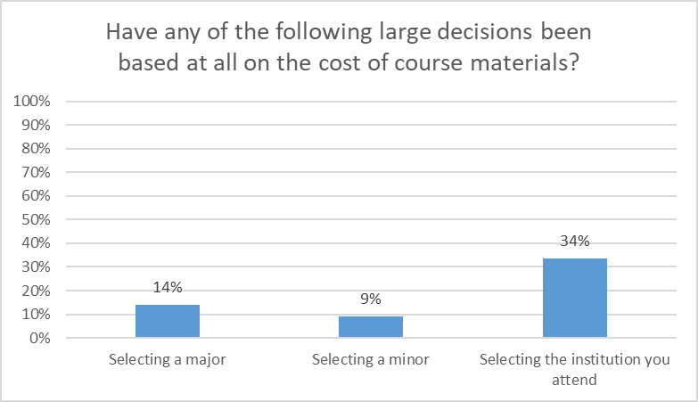
Impact on Large Decisions
“I was originally a biology major, but am now an English major. The biology textbooks were extremely expensive and hardly ever fully used. There is a significant price difference in textbooks depending on your major.”
“As a student working towards double-majoring in business and biology: I am more likely to drop my business major than my biology major, because I can take more classes for less money….”
Course material costs were a factor for many private institution students in large decisions, particularly major and institution selection.

Slide 8
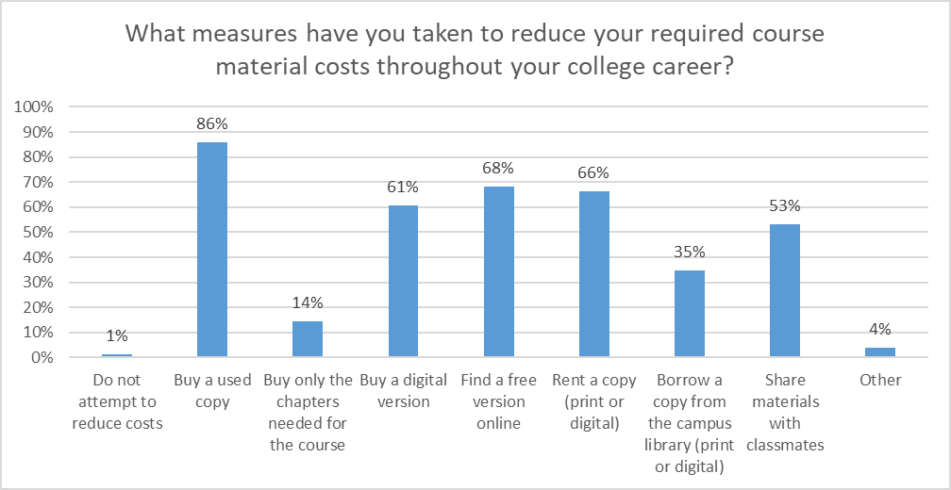
Measures to Reduce Costs
Only 1% of private institution students do not attempt to reduce their course material costs, with the most common approaches being buying used copies and finding a free version online.

Slide 9
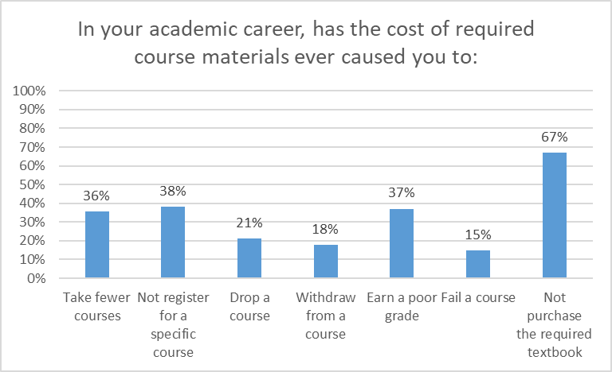
Academic Career Impact
The results show the deep impact of course material costs on Virginia private institution students’ academic careers, from progress (36% have taken fewer courses, 21% have dropped courses, and 18% have withdrawn from courses) to opportunity (38% have not registered for a specific course) to success (37% have earned a poor grade and 15% have failed a course).

Slide 10
Course-Level Impact
“I have chosen to take different courses and considered dropping courses because the textbooks were too expensive for me to afford.”
“I typically struggle to afford textbooks or online course access codes for websites, so I typically only take courses that I can borrow a textbook from a friend or classmate, or if I need to take a course that requires paid online access in addition to the class, I have to plan well in advance to save the money to purchase the online access.”
“I try to take classes with a professor who doesn't require a textbook or other additional fees.”
“The cost of course materials stresses me out, since its an addition to the high tuition I already pay to go to university. It makes the education I want to get less accessible, since I often try to find alternative courses that don't have additional course fees in them. I didn't take a class this year because the cheapest I could find the book was $180, which is much too expensive for one textbook for one class.”
“Access codes especially are a stressor because it is almost impossible to find a more affordable alternative.”
Private institution students described course by course decisions based on course material costs, often mentioning the challenge of homework programs/access codes.

Slide 11
Broad Impact
“There have been multiple occasions when I have had to choose between paying for a textbook or buying groceries for myself. There have been multiple occasions when I had to not take a prescription medicine because I could not afford to pay for my meds and my textbooks.”
“The cost of course materials is mentally and emotionally exhausting…My textbooks and course codes can be up to $500 sometimes, which is almost as much as our rent each month. This financial stress really distracts from school work. ”
“I have enough trouble paying for tuition; housing costs take priority for me over textbooks. I have failed at least three courses from textbook expenses causing me to not be able to buy the textbook.”
“I couldn’t afford groceries or personal products because I had to spend over $700 on course materials at the beginning of the semester.”
Private institution students also mentioned the impact of course material costs on their life and wellness.

Slide 12
Examining Educational Equity

Slide 13
Identified Areas of Concern
The Survey Task Force identified seven demographic areas of particular concern:
Funding Sources (percentages are specific to private institution students):
30% are using the Pell Grant Program to fund their education
50% are using Education Loans to fund their education
12% are using Full Time Job(s) to fund their education
Social Aspects (percentages are specific to private institution students):
29% selected a race/ethnicity other than or in addition to White (defined here as Non White-Only)
30% identify as First Generation students
12% are currently taking care of children, parents, or other family members
7% identified as having a Disability, and over half of these said that their disability affects how they use course materials

Slide 14
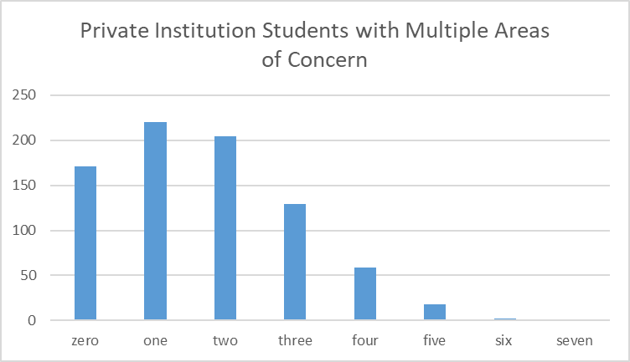
Populations of Concern
The number of areas of concern an individual student had was tracked to see if there were patterns in responses.

Slide 15
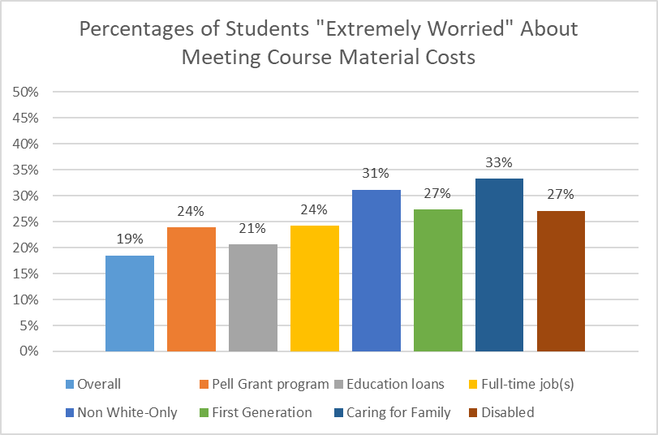
Worry about Course Material Costs
All of the areas of concern had higher proportions of private institution students who were “Extremely worried” about meeting their course materials costs than the overall group.

Slide 16
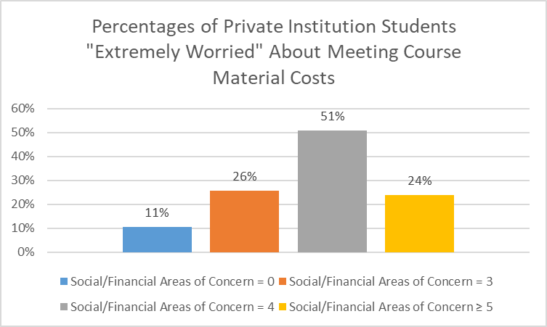
Worry about Course Material Costs
*
*This pattern is different than was found elsewhere in the study, where the relevant percentage typically went up for students with 5 or more social/financial areas of concern. However, it should be noted that there is a small number of respondents (only 21) in the group of private institution students with 5 or more social/financial areas of concern.
The effect on private institution student worry generally grew with increasing numbers of the seven areas of concern identified. A First Generation, disabled student using Pell Grant funding, for example, would be more likely to be “Extremely Worried” about meeting course material costs than a student without any of the areas.

Slide 17
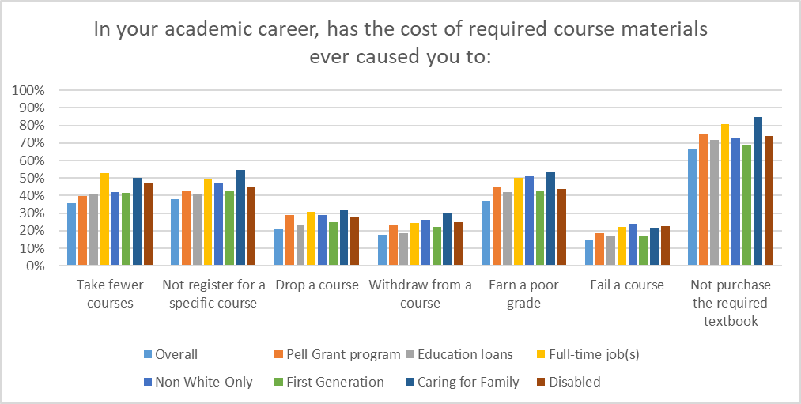
Academic Career Impact
Private institution students in the areas of concern often showed higher percentages dealing with academic career challenges from the cost of required course materials than the overall population.

Slide 18
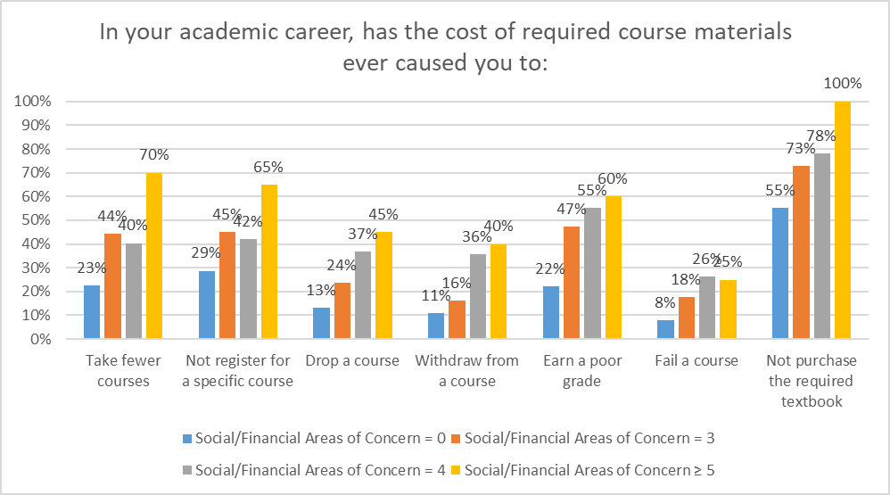
Academic Career Impact
The effect on academic career challenges for private institution students grew with increasing numbers of the seven areas of concern identified.

Slide 19
Examining Course Materials

Slide 20
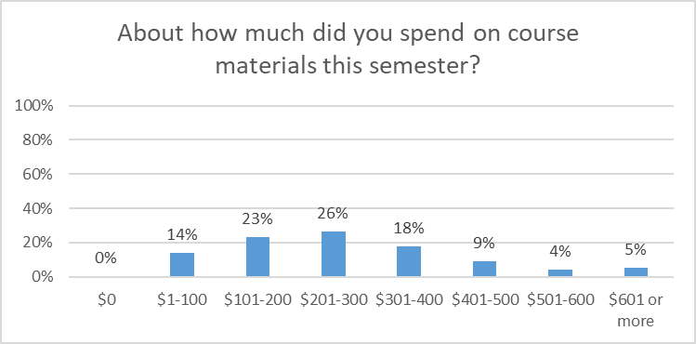
Course Materials Expenditures
Around half of the private institution students noted that they had spent between $101 and $300 on course materials this semester; around a third had spent between $301 and $600; and 5% had spent more than $601.

Slide 21
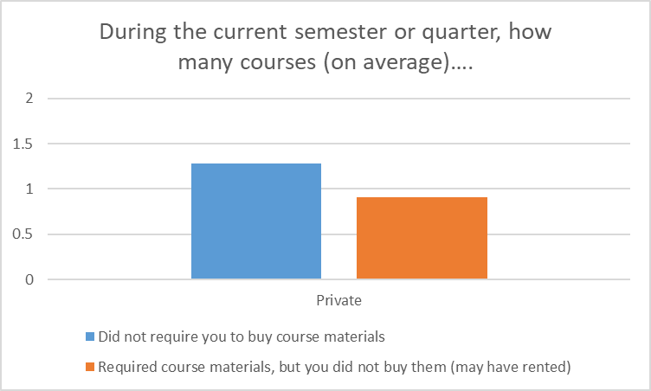
Required Materials
Private institution students reported that, on average, around 1.3 courses in the current semester or quarter did not require them to buy course materials. As a group, they did not buy required course materials for an average of 0.9 courses, although they may have rented them.

Slide 22
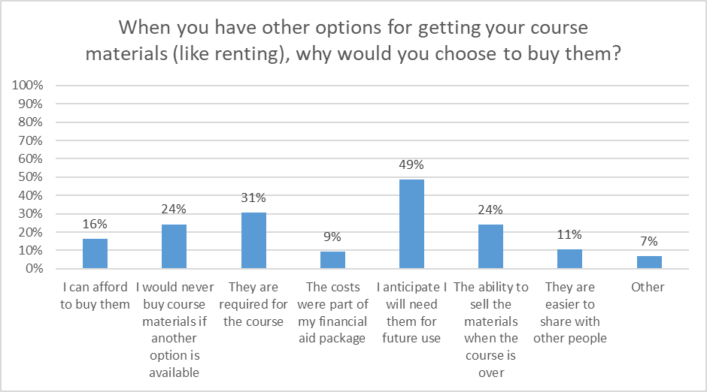
Course Materials Value
The most commonly cited reason to buy (rather than rent) course materials was anticipation of future use. If future use is an important consideration for Virginia students, there may be issues when students only have access to course materials for a limited time, such as through access codes.

Slide 23
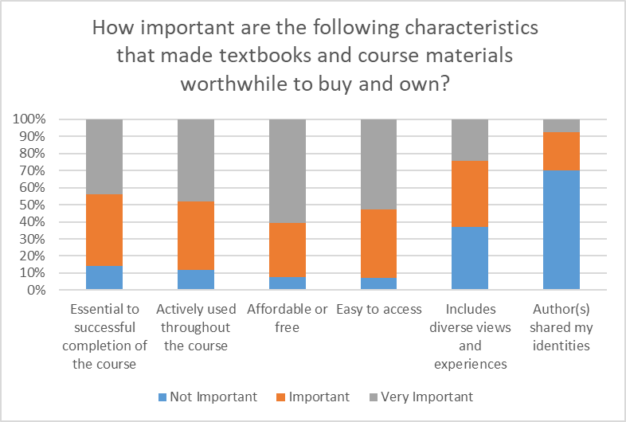
Course Materials Value
The most important characteristics that made course materials worthwhile to buy and own for students at private institutions were that they were affordable/free, easy to access, actively used throughout the course, and essential to successful completion of the course.

Slide 24
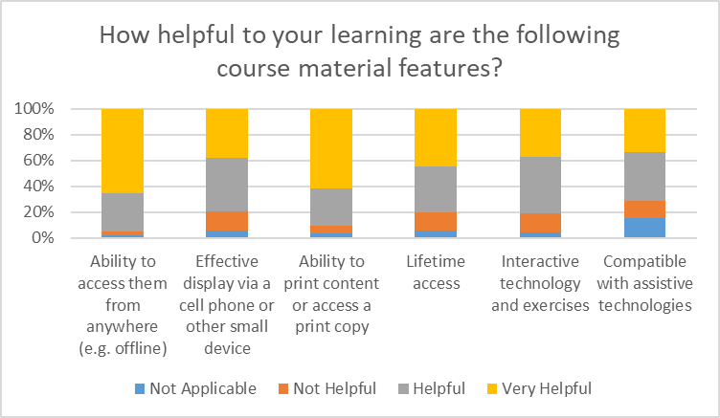
Course Materials Value
The most helpful aspects of course materials for students from private institutions were the ability to access them from anywhere (e.g. offline) and the ability to obtain a print version.

Slide 25
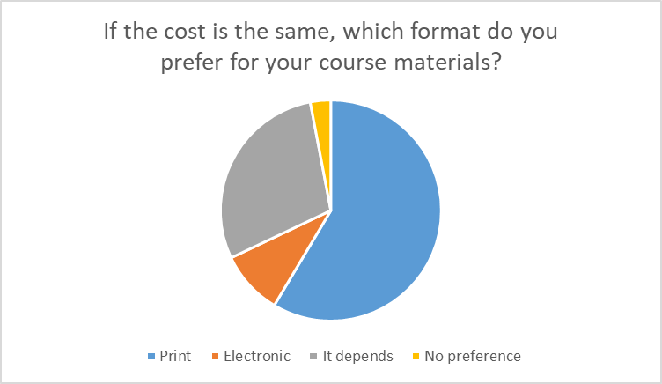
Print vs. Electronic
More than half (almost 60%) of private institution respondents preferred the print format for course materials, and almost a third said that it depends.

Slide 26
Next Steps
This is intended to be a soft release of initial findings so that institutions can begin to discuss the local and statewide implications of the results.
A summary report is planned for Summer 2022.
If you have any questions, please contact viva@gmu.edu.

