Slide 1

Virginia Course Materials Survey 2021
Initial results, limited to Four Year institution students, April 1, 2022
A summary report is forthcoming in summer 2022

Slide 2
“Paying for school out of pocket was always a challenge, but affording textbooks in addition felt the hardest.”
- Four year institution Student respondent

Slide 3
Virginia Course Materials Survey
Conducted from October 1-December 31, 2021
More than 5,600 valid student responses from 41 institutions were received, reflecting an overall response rate of 10%.
Overarching research questions of the survey:
  What is the impact of course material costs on educational equity among Virginia students?
  What course content materials do students find to be most beneficial to their learning?
The full survey instrument is available here: https://vivalib.org/va/open/survey.

Slide 4
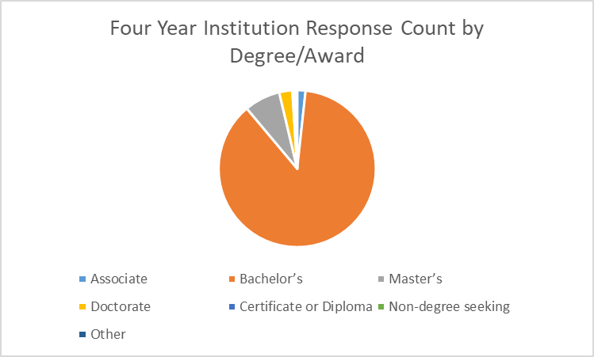
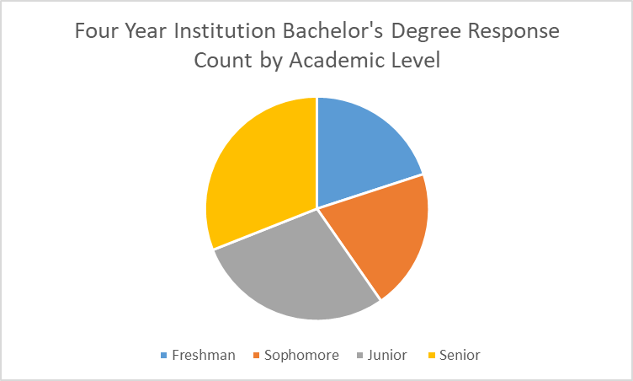
Four Year Institutions Focus
The results in this presentation are limited to the 703 four year institution students who took this survey. The students were from the following institutions:
James Madison University
Norfolk State University
Radford University
University of Mary Washington
Virginia Military Institute

Slide 5
Examining the Impact on Students

Slide 6
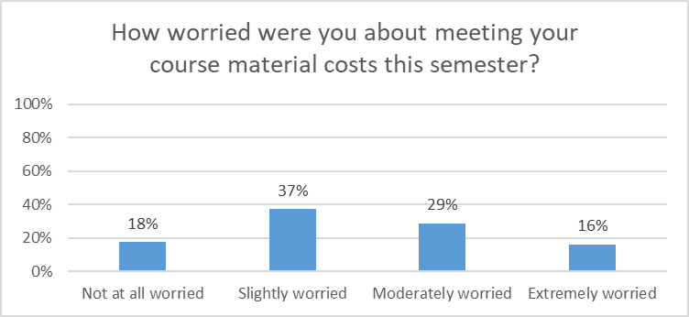
Worry about Course Material Costs
82% of all four year institution student respondents had some level of worry, including 16% who were “Extremely Worried,” about meeting their course material costs.

Slide 7
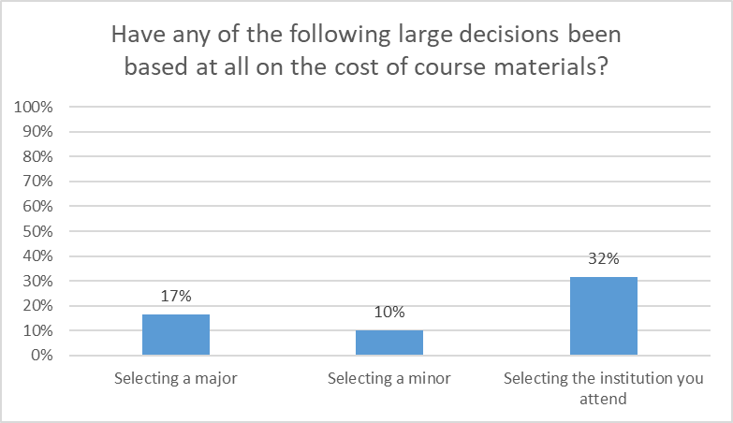
Impact on Large Decisions
“I might even have to change my major to one that has classes with materials that are less costly.”
“It has made taking science classes harder because the texts cost so much.”
Course material costs were a factor for many four year institution students in the large decisions of major/minor/institution selection.

Slide 8
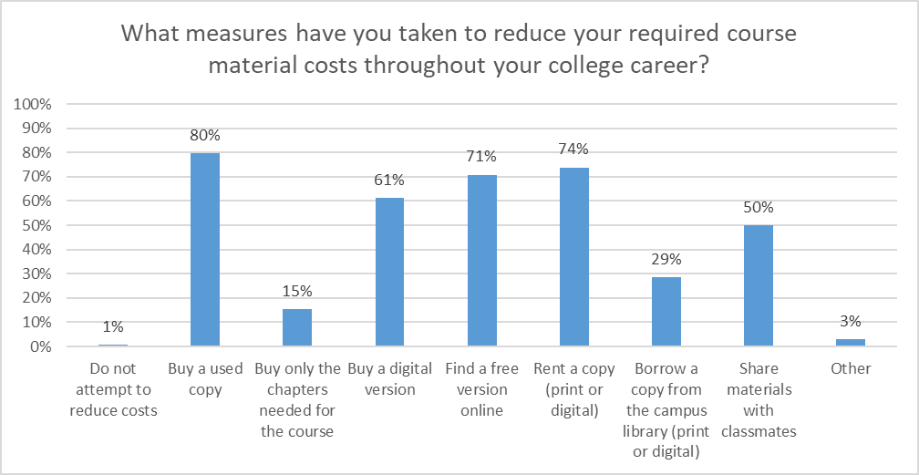
Measures to Reduce Costs
Only 1% of four year institution students do not attempt to reduce their course material costs, with the most common approaches being buying used copies, renting a copy, or finding a free version online.

Slide 9
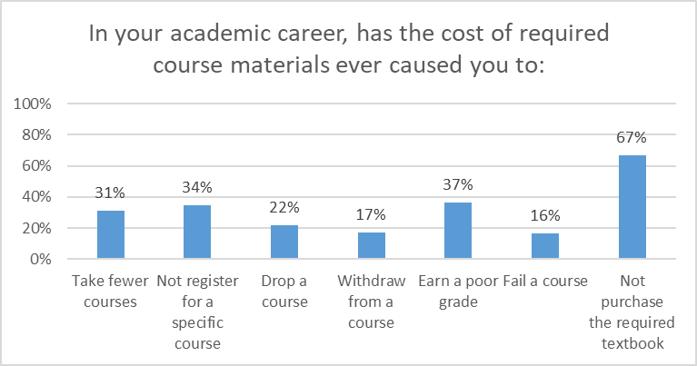
Academic Career Impact
The results show the deep impact of course material costs on Virginia four year institution students’ academic careers, from progress (31% have taken fewer courses, 22% have dropped courses, and 17% have withdrawn from courses) to opportunity (34% have not registered for a specific course) to success (37% have earned a poor grade and 16% have failed a course).

Slide 10
Course-Level Impact
“I always check the required books first before registering for the class. I have chosen to not take certain courses even though they interest me due to material costs.”
“If a course requires an expensive textbook, I will most likely drop the class. I am also likely to drop a class if there are many different required books along with the textbook.”
“[S]pending more on materials makes me go into courses begrudgingly, rather than with a positive outlook.”
“It is outrageous to pay $200 for an access code to a website for one class.”
Four year institution students described course by course decisions based on course material costs, often mentioning the challenge of homework programs/access codes.

Slide 11
Broad Impact
“I pay for school on my own as well as everyday things such as rent, groceries, etc. and when textbooks can cost almost $500 that is a month of my rent. I take my chances on not having the book because I definitely need a place to live.”
“By spending money on materials, I couldn't spend money on other needs (groceries, bills, gas) or supplies (pencils, paper, binder) that were needed.”
“Having to come out of my own pocket to pay for course materials has been a major hindrance to college students, and speaking from experience, has become a stressful process. If I am overwhelmed from having to pay for things that I feel should be provided by the school, it makes it harder for me put all my energy and focus into my school work.”
Four year institution students also mentioned the impact of course material costs on their life and wellness.

Slide 12
Examining Educational Equity

Slide 13
Identified Areas of Concern
The Survey Task Force identified seven demographic areas of particular concern:
Funding Sources (percentages are specific to four year institution students):
26% are using the Pell Grant Program to fund their education
40% are using Education Loans to fund their education
10% are using Full Time Job(s) to fund their education
Social Aspects (percentages are specific to four year institution students):
41% selected a race/ethnicity other than or in addition to White (defined here as Non White-Only)
25% identify as First Generation students
13% are currently taking care of children, parents, or other family members
10% identified as having a Disability, and over half of these said that their disability affects how they use course materials

Slide 14
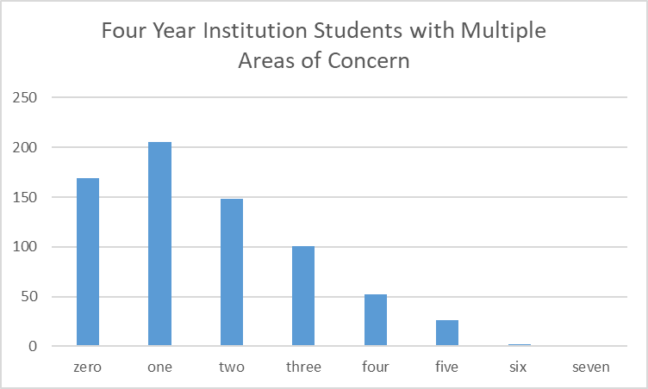
Populations of Concern
The number of areas of concern an individual student had was tracked to see if there were patterns in responses.

Slide 15
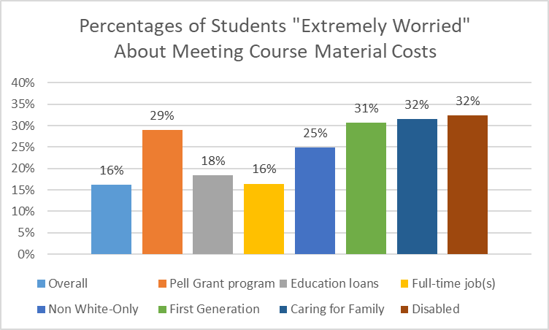
Worry about Course Material Costs
All but one of the areas of concern had higher proportions of four year institution students who were “Extremely worried” about meeting their course materials costs than the overall group.

Slide 16
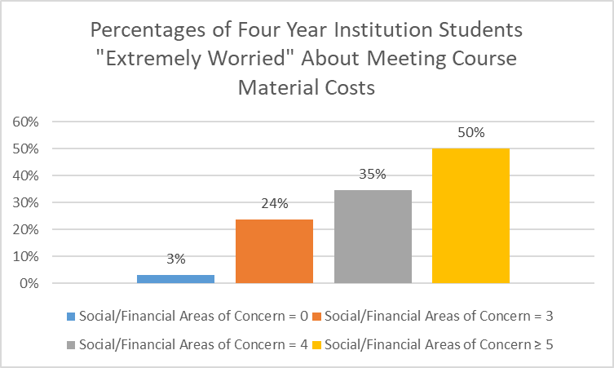
Worry about Course Material Costs
The effect on four year institution student worry grew with increasing numbers of the seven areas of concern identified. A First Generation, disabled student using Pell Grant funding, for example, would be more likely to be “Extremely Worried” about meeting course material costs than a student without any of the areas.

Slide 17
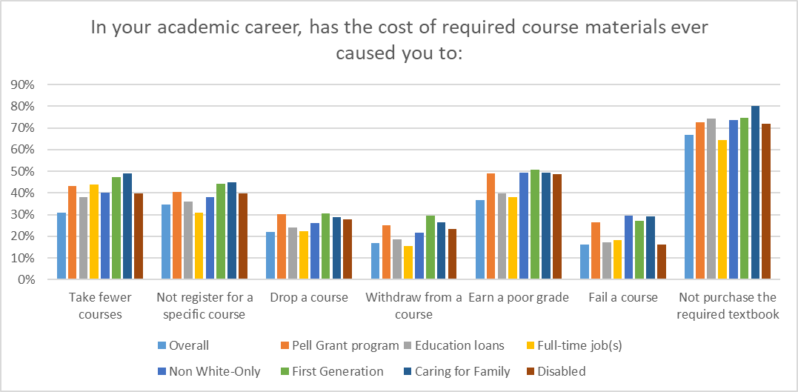
Academic Career Impact
Four year institution students in the areas of concern often showed higher percentages dealing with academic career challenges from the cost of required course materials than the overall population.

Slide 18
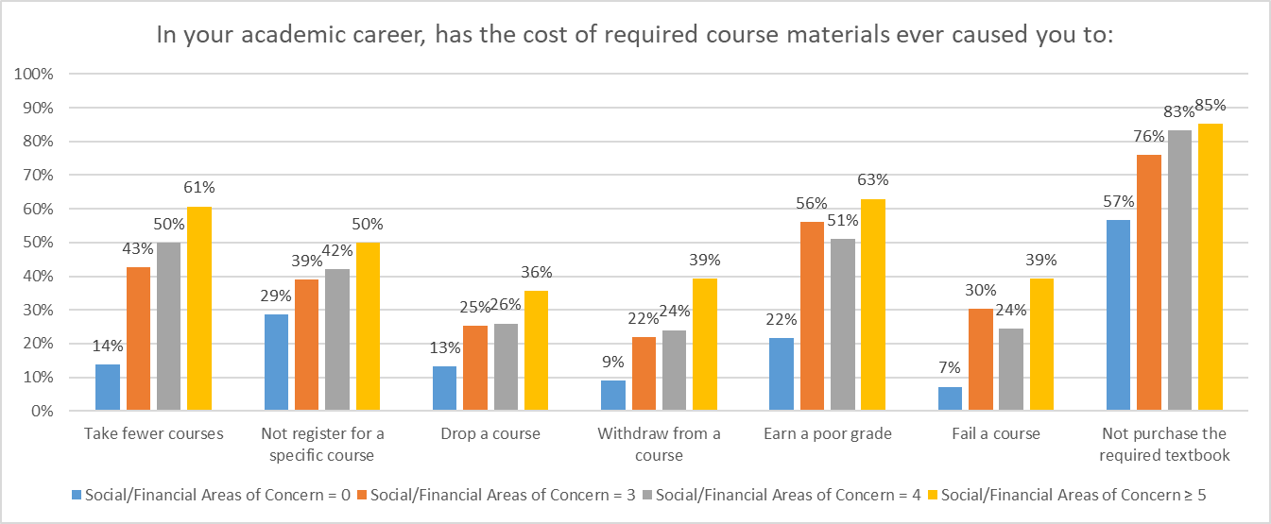
Academic Career Impact
The effect on academic career challenges for four year institution students grew with increasing numbers of the seven areas of concern identified.

Slide 19
Examining Course Materials

Slide 20
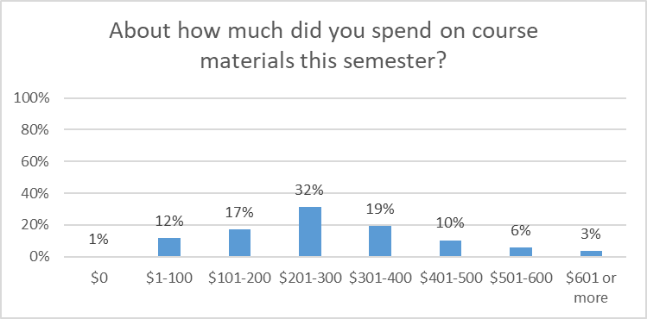
Course Materials Expenditures
Around half of the four year institution students noted that they had spent between $101 and $300 on course materials this semester around a third had spent between $301 and $600; and 3% had spent more than $601.

Slide 21
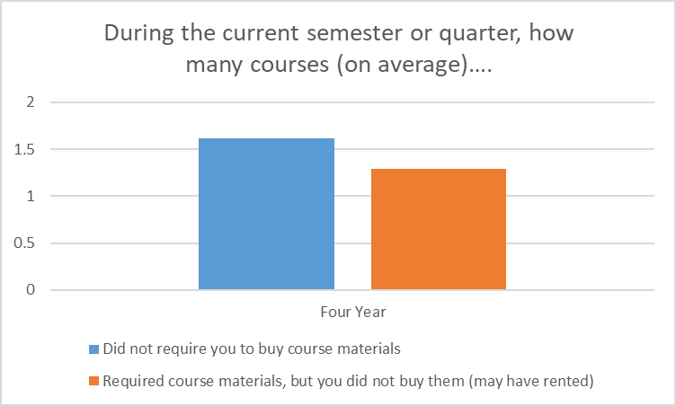
Required Materials
Four year institution students reported that, on average, around 1.6 courses in the current semester or quarter did not require them to buy course materials. As a group, they did not buy required course materials for an average of 1.3 courses, although they may have rented them.

Slide 22
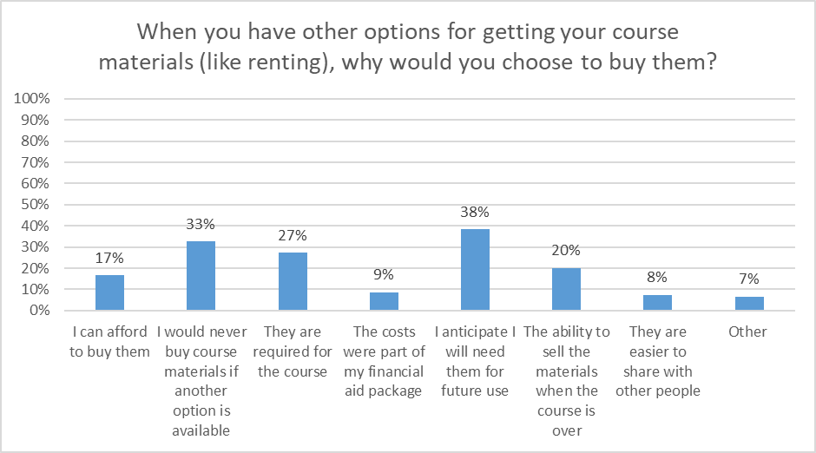
Course Materials Value
The most commonly cited reason to buy (rather than rent) course materials was anticipation of future use. If future use is an important consideration for Virginia students, there may be issues when students only have access to course materials for a limited time, such as through access codes.

Slide 23
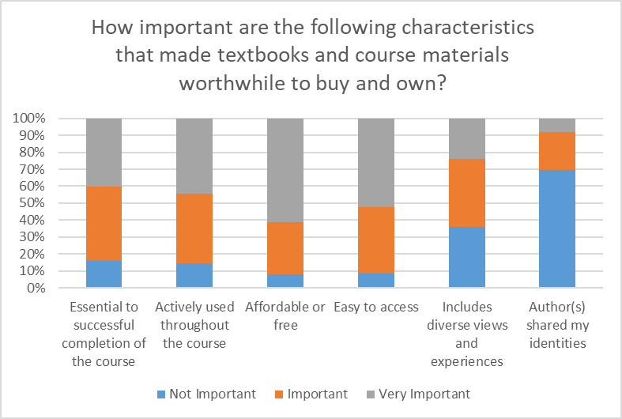
Course Materials Value
The most important characteristics that made course materials worthwhile to buy and own for students at four year institutions were that they were affordable/free, easy to access, actively used throughout the course, and essential to successful completion of the course.

Slide 24
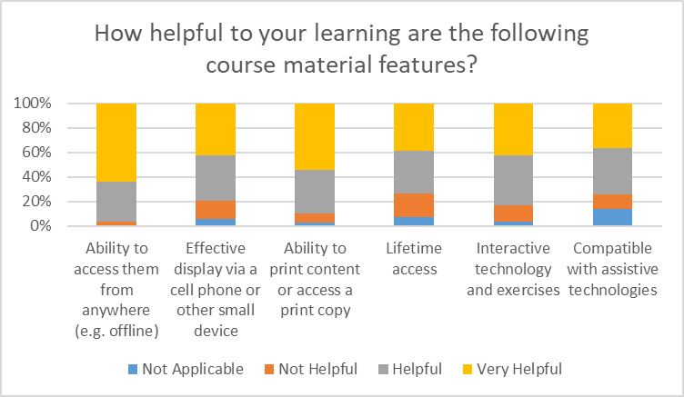
Course Materials Value
The most helpful aspects of course materials for students from four year institutions were the ability to access them from anywhere (e.g. offline) and the ability to obtain a print version.

Slide 25
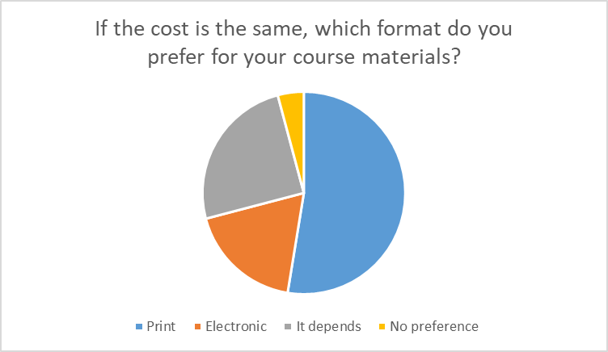
Print vs. Electronic
Slightly more than half of four year institution respondents preferred the print format for course materials, and around a quarter said that it depends.

Slide 26
Next Steps
This is intended to be a soft release of initial findings so that institutions can begin to discuss the local and statewide implications of the results.
A summary report is planned for Summer 2022.
If you have any questions, please contact viva@gmu.edu.

