Slide 1

Virginia Course Materials Survey 2021
Initial results, limited to doctoral institution students, April 1, 2022
A summary report is forthcoming in summer 2022

Slide 2
“I ration my grocery bill during the summer and fall to afford textbooks, so not eating as much as I should impacts my ability to focus on all of my classes for the majority of the semester.”
- Doctoral institution Student respondent

Slide 3
Virginia Course Materials Survey
Conducted from October 1-December 31, 2021
More than 5,600 valid student responses from 41 institutions were received, reflecting an overall response rate of 10%.
Overarching research questions of the survey:
  What is the impact of course material costs on educational equity among Virginia students?
  What course content materials do students find to be most beneficial to their learning?
The full survey instrument is available here: https://vivalib.org/va/open/survey.

Slide 4
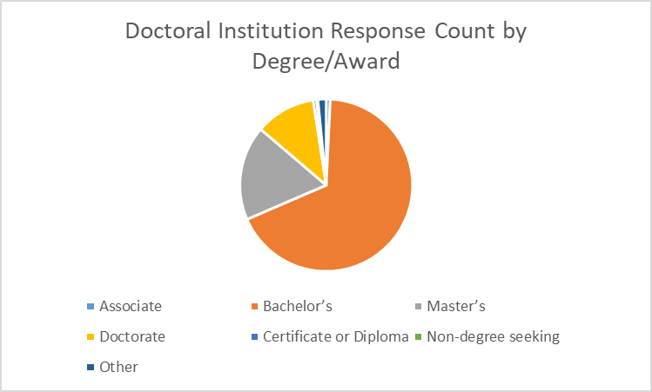
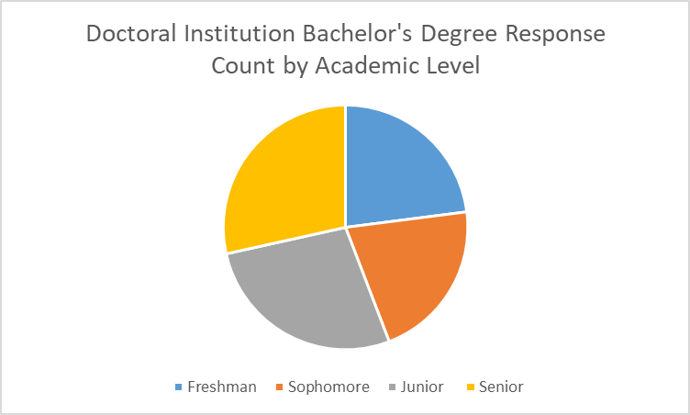
Doctoral Institutions Focus
The results in this presentation are limited to the 3,296 doctoral institution students who took this survey. The students were from the following institutions:
George Mason University
Old Dominion University
University of Virginia
Virginia Tech
Virginia Commonwealth University
William & Mary

Slide 5
Examining the Impact on Students

Slide 6
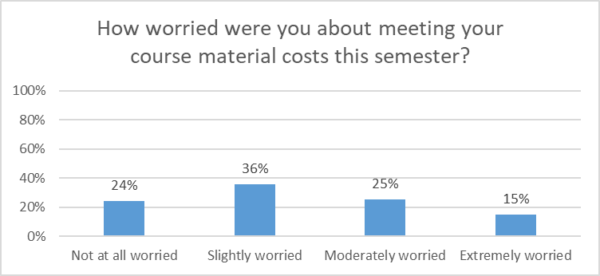
Worry about Course Material Costs
76% of all doctoral institution student respondents had some level of worry, including 15% who were “Extremely Worried,” about meeting their course material costs.

Slide 7
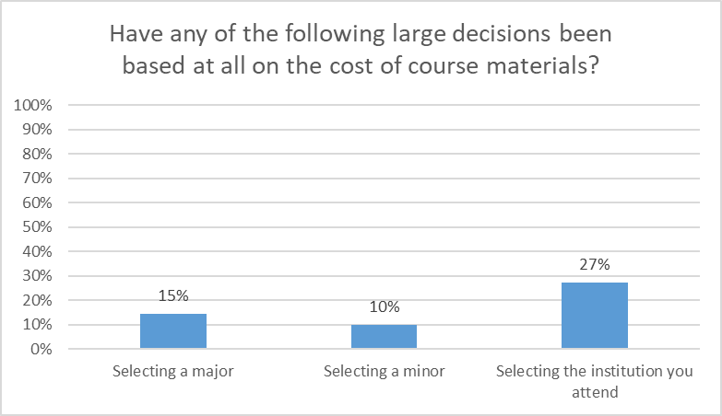
Impact on Large Decisions
“Often times in stem courses I couldn't afford the books, which led me to not pursuing my original major.”
“I changed my bachelor’s major to something that required less expensive and more accessible materials.”
“Not being able to purchase access codes and required textbooks…has resulted in needing to switch classes and switch majors due to the cost of textbooks.”
Course material costs were a factor for many doctoral institution students in the large decisions of major/minor/institution selection.

Slide 8
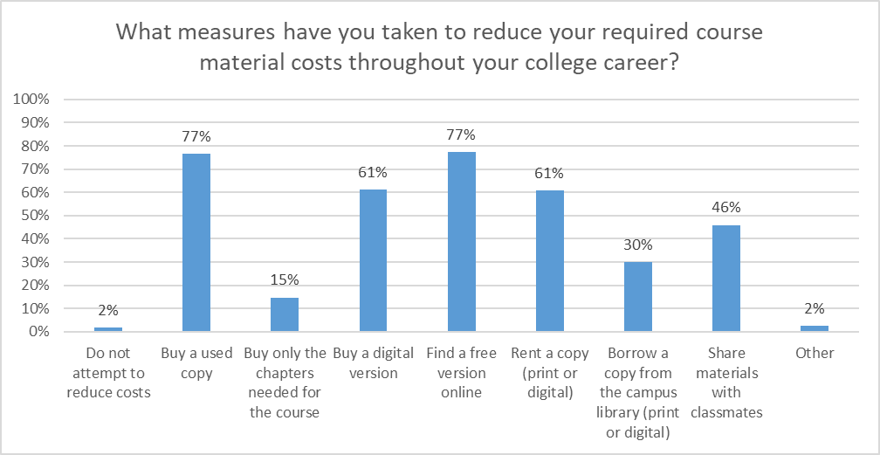
Measures to Reduce Costs
Only 2% of doctoral institution students do not attempt to reduce their course material costs, with the most common approaches being buying used copies or finding a free version online.

Slide 9
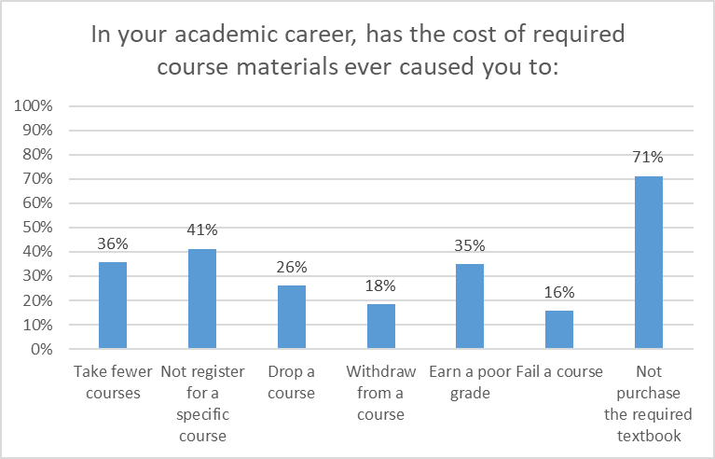
Academic Career Impact
The results show the deep impact of course material costs on Virginia doctoral institution students’ academic careers, from progress (36% have taken fewer courses, 26% have dropped courses, and 18% have withdrawn from courses) to opportunity (41% have not registered for a specific course) to success (35% have earned a poor grade and 16% have failed a course).

Slide 10
Course-Level Impact
“There were some classes that required homework programs that I had to pay for and it caused me to drop the class….”
“In the past I have specifically selected courses with a zero cost text option.”
“Coughing up over $100 for one specific edition of a textbook that hasn't changed much in the last decade because you need a specific access code or because a professor ‘highly encourages’ a specific version is very annoying, even aggravating if the text is only used as reference and not a learning material.”
“[B]uying used copies is not an option for most classes because they require online access codes which makes textbook costs even greater.”
Doctoral institution students described course by course decisions based on course material costs, often mentioning the challenge of homework programs/access codes.

Slide 11
Broad Impact
“Spending money on textbooks and other required course materials has caused major setbacks in saving for housing, food, and other educational opportunities like study abroad programs.”
“Simply adding it to the pile of student loan debt is not a good alternative and is setting graduates up to further struggle to pay student loans.”
“Exorbitant textbook and program/software costs cause me an extreme amount of stress at the beginning of the school year and often throughout the semester as I feel behind my classmates and unable to perform to my best ability.”
Doctoral institution students also mentioned the impact of course material costs on their life and wellness.

Slide 12
Examining Educational Equity

Slide 13
Identified Areas of Concern
The Survey Task Force identified seven demographic areas of particular concern:
Funding Sources (percentages are specific to doctoral institution students):
23% are using the Pell Grant Program to fund their education
36% are using Education Loans to fund their education
15% are using Full Time Job(s) to fund their education
Social Aspects (percentages are specific to doctoral institution students):
47% selected a race/ethnicity other than or in addition to White (defined here as Non White-Only)
26% identify as First Generation students
13% are currently taking care of children, parents, or other family members
8% identified as having a Disability, and over half of these said that their disability affects how they use course materials

Slide 14
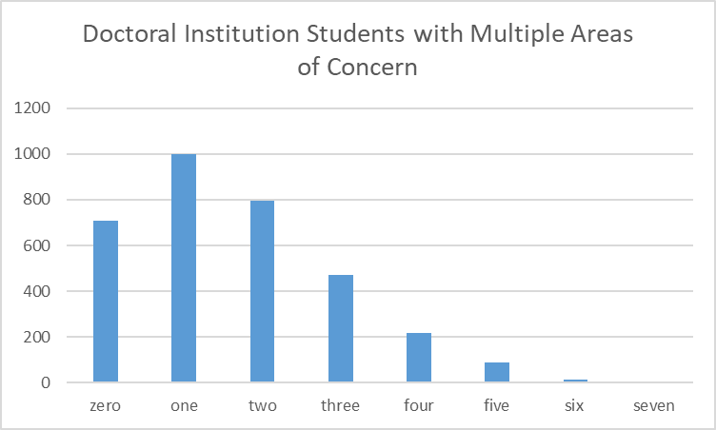
Populations of Concern
The number of areas of concern an individual student had was tracked to see if there were patterns in responses.

Slide 15
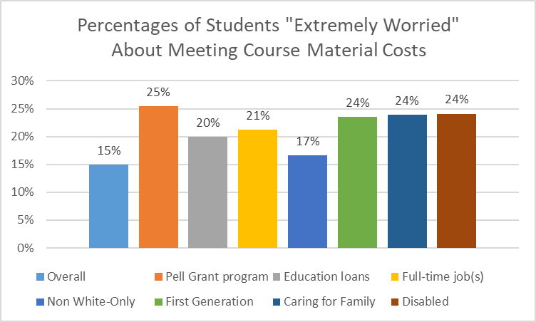
Worry about Course Material Costs
Each of the areas of concern had higher proportions of doctoral institution students who were “Extremely worried” about meeting their course materials costs than the overall group.

Slide 16
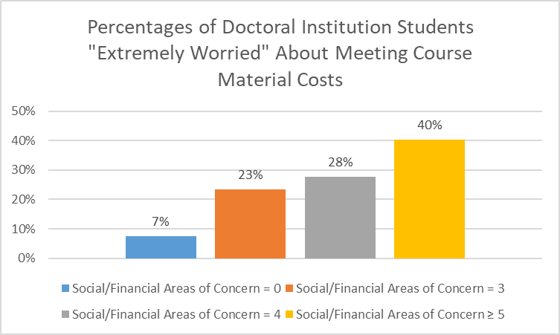
Worry about Course Material Costs
The effect on doctoral institution student worry grew with increasing numbers of the seven areas of concern identified. A First Generation, disabled student using Pell Grant funding, for example, would be more likely to be “Extremely Worried” about meeting course material costs than a student without any of the areas.

Slide 17
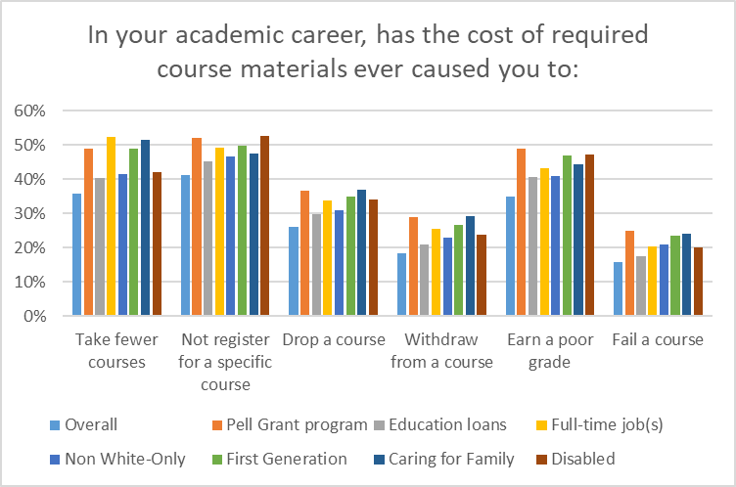
Academic Career Impact
Doctoral institution students in the areas of concern consistently showed higher percentages dealing with academic career challenges from the cost of required course materials than the overall population.

Slide 18
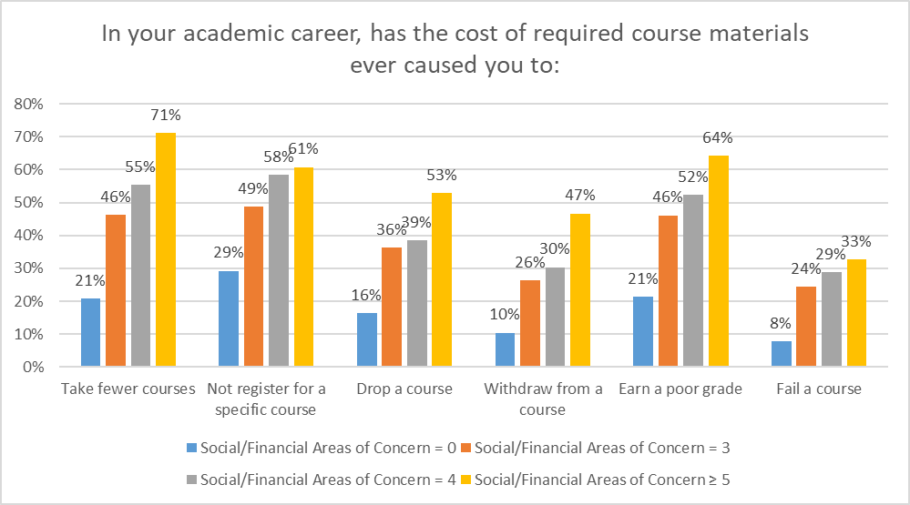
Academic Career Impact
The effect on academic career challenges for doctoral institution students grew with increasing numbers of the seven areas of concern identified.

Slide 19
Examining Course Materials

Slide 20
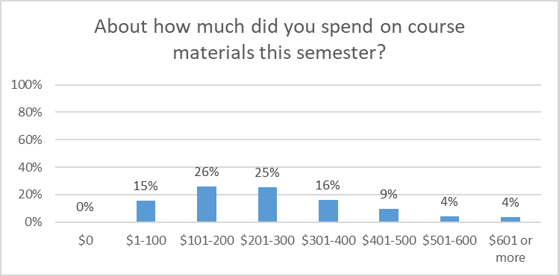
Course Materials Expenditures
Around half of the doctoral institution students noted that they had spent between $101 and $300 on course materials this semester; around a third had spent between $301 and $600; and 4% had spent more than $601.

Slide 21
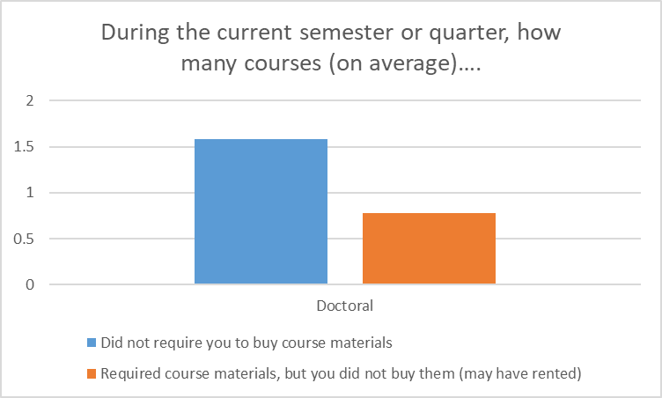
Required Materials
Doctoral institution students reported that, on average, around 1.5 courses in the current semester or quarter did not require them to buy course materials. As a group, they did not buy required course materials for an average of 0.75 courses, although they may have rented them.

Slide 22
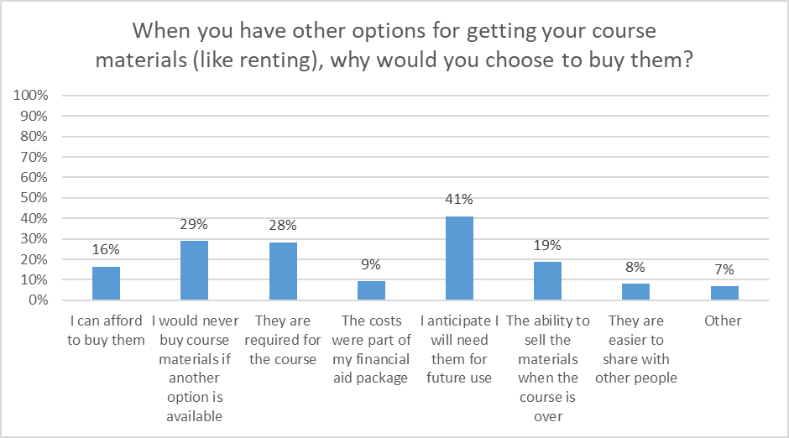
Course Materials Value
The most commonly cited reason to buy (rather than rent) course materials was anticipation of future use. If future use is an important consideration for Virginia students, there may be issues when students only have access to course materials for a limited time, such as through access codes.

Slide 23
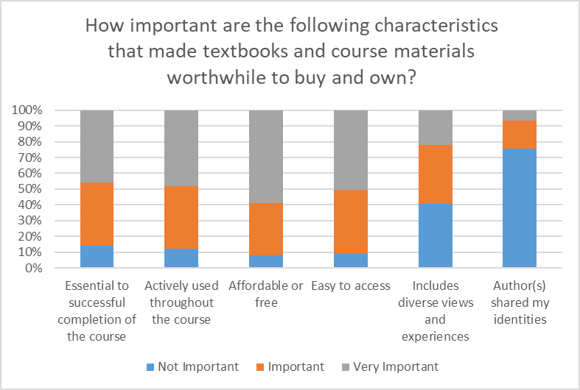
Course Materials Value
The most important characteristics that made course materials worthwhile to buy and own for students at doctoral institutions were that they were affordable/free, easy to access, actively used throughout the course, and essential to successful completion of the course.

Slide 24
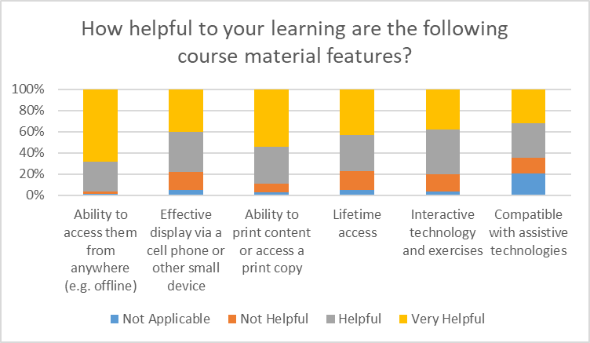
Course Materials Value
The most helpful aspects of course materials for students from doctoral institutions were the ability to access them from anywhere (e.g. offline) and the ability to obtain a print version.

Slide 25
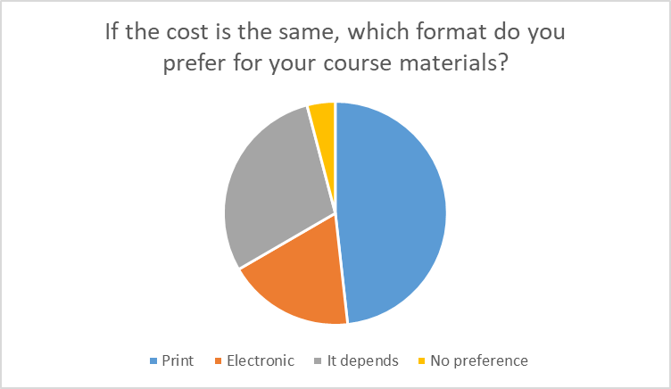
Print vs. Electronic
Slightly less than half of doctoral institution respondents preferred the print format for course materials, and close to a third said that it depends.

Slide 26
Next Steps
This is intended to be a soft release of initial findings so that institutions can begin to discuss the local and statewide implications of the results.
A summary report is planned for Summer 2022.
If you have any questions, please contact viva@gmu.edu.

