Slide 1

Virginia Course Materials Survey 2021
Initial results, February 22, 2022
A formal report is forthcoming in Spring 2022

Slide 2
“I ration my grocery bill during the summer and fall to afford textbooks, so not eating as much as I should impacts my ability to focus on all of my classes for the majority of the semester.”
- Student respondent

Slide 3
Virginia Course Materials Survey
Conducted from October 1-December 31, 2021
More than 5,600 valid student responses from 41 institutions were received, reflecting an overall response rate of 10%.
Overarching research questions of the survey:
  What is the impact of course material costs on educational equity among Virginia students?
  What course content materials do students find to be most beneficial to their learning?
The full survey instrument is available here: https://vivalib.org/va/open/survey.

Slide 4
Examining the Impact on Students

Slide 5
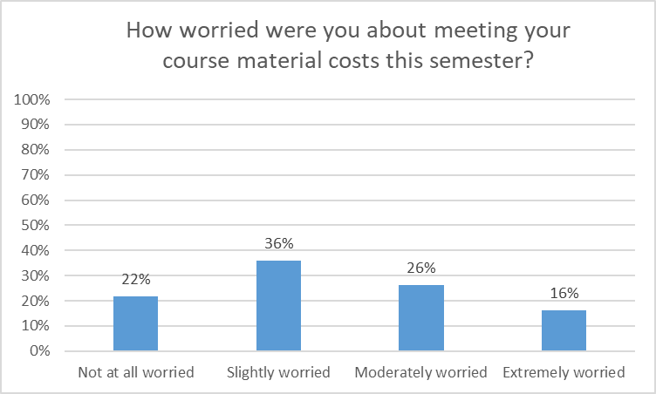
Worry about Course Material Costs
16% of all student respondents were “Extremely Worried” about meeting their course material costs, and 78% had some level of worry.

Slide 6
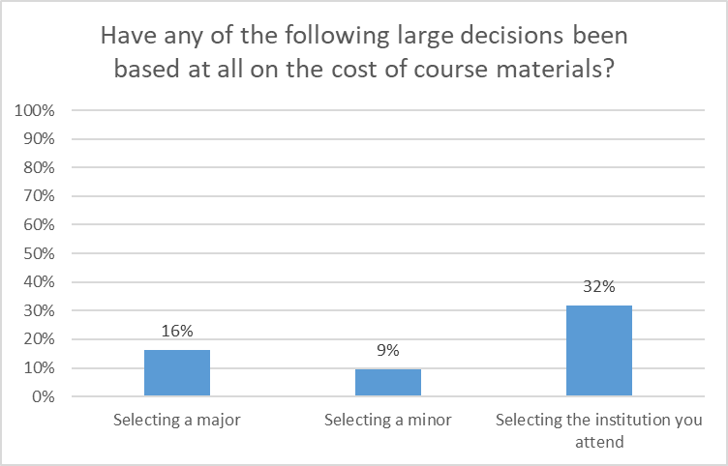
Impact on Large Decisions
“Often times in stem courses I couldn't afford the books, which led me to not pursuing my original major.”
“I changed my bachelor’s major to something that required less expensive and more accessible materials.”
“I was originally a biology major, but am now an English major. The biology textbooks were extremely expensive and hardly ever fully used.”
Course material costs were a factor for many students in the large decisions of major/minor/institution selection.

Slide 7
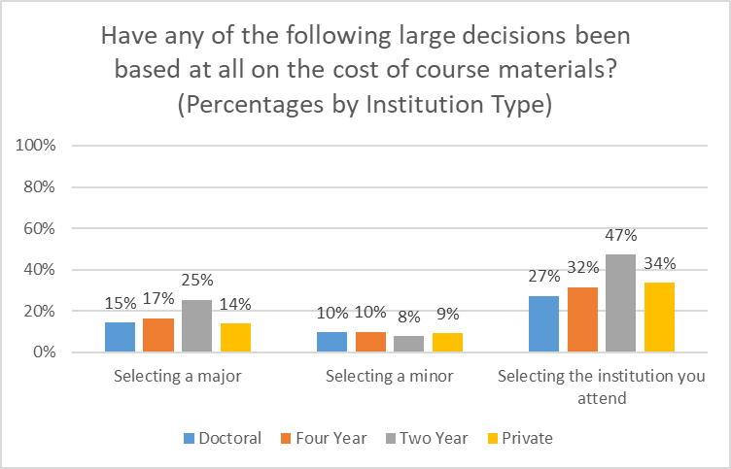
Impact on Large Decisions
The impact of major selection and selecting the institution attended was especially great on students at two year institutions.

Slide 8
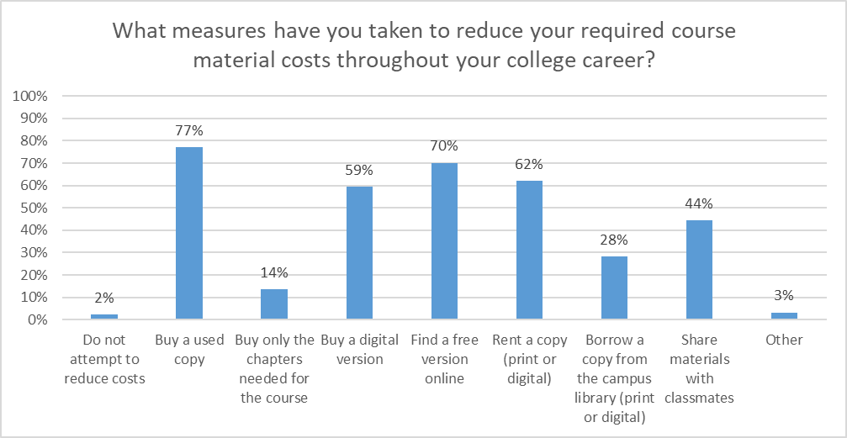
Measures to Reduce Costs
Only 2% of students do not attempt to reduce their course material costs, with the most common approaches being buying used copies or finding a free version online.

Slide 9
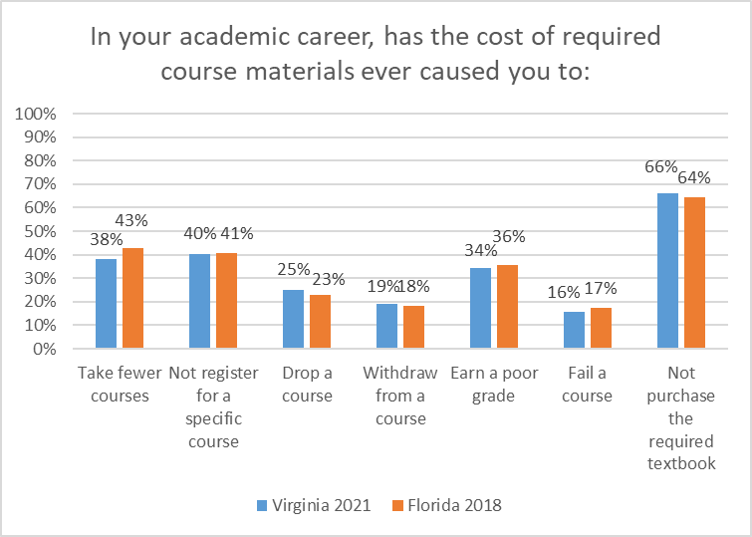
Academic Career Impact
The results show the deep impact of course material costs on Virginia students’ academic careers, from progress (38% have taken fewer courses) to opportunity (40% have not registered for a specific course) to success (34% have earned a poor grade and 16% have failed).
These results closely mirror the results of the 2018 Florida Student Textbook and Course Materials Survey, further validating that they are broad, shared challenges in higher education.

Slide 10
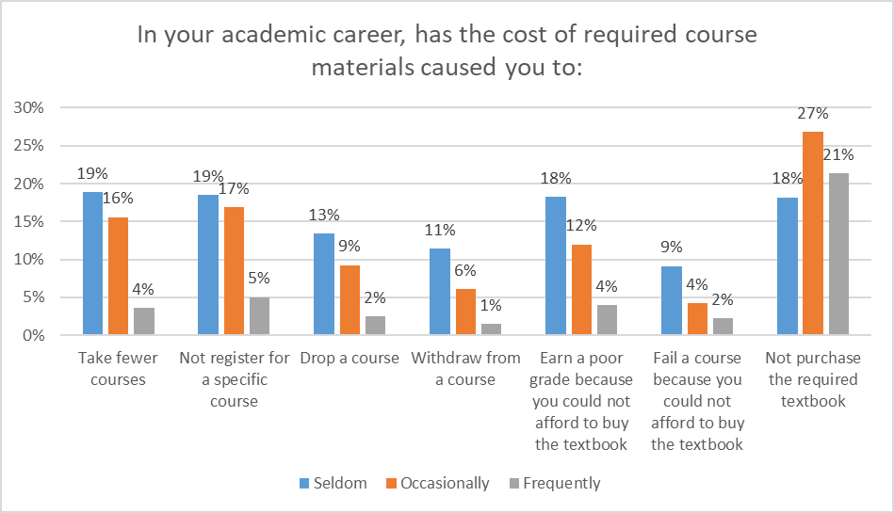
Academic Career Impact
“High cost of course materials is a form of classism, truly. If a student is unable to purchase what they need for a class, they are already behind from the beginning.”
Looking more closely at the students who have had these experiences, there are smaller but important subsets of students who have had these difficult situations happen “Frequently.”

Slide 11
Course-Level Impact
“In the past I have specifically selected courses with a zero cost text option.”
“There were some classes that required homework programs that I had to pay for and it caused me to drop the class….”
“I struggled to take one course my Freshman year due to a textbook that cost upwards of $200 - it was required for my major but I was forced to put it off.”
“[B]uying used copies is not an option for most classes because they require online access codes which makes textbook costs even greater.”
Students described course by course decisions based on course material costs, often mentioning the challenge of homework programs/access codes.

Slide 12
Broad Impact
“Spending money on textbooks and other required course materials has caused major setbacks in saving for housing, food, and other educational opportunities like study abroad programs.”
“I have to buy books and a parking pass and literally have all of $70 left to buy groceries and that’s hard.”
“Didn’t feel like I could provide for my family or continue my education because I had to choose between food and a roof over our head or a textbook.”
Students also mentioned the impact of course material costs on their life and wellness.

Slide 13
Examining Educational Equity

Slide 14
Identified Areas of Concern
The Survey Task Force identified seven demographic areas of particular concern:
Funding Sources:
28.9% are using the Pell Grant Program to fund their education
35.4% are using Education Loans to fund their education
16.3% are using Full Time Job(s) to fund their education
Social Aspects:
41.9% selected a race/ethnicity other than or in addition to White (defined here as Non White-Only)
30% identify as First Generation students
18% are currently taking care of children, parents, or other family members
8.6% identified as having a Disability, and over half of these said that their disability affects how they use course materials

Slide 15
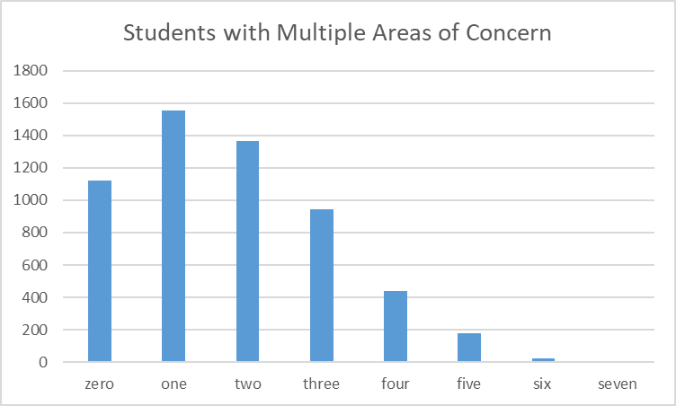
Populations of Concern
The number of areas of concern an individual student had was tracked to see if there were patterns in responses.

Slide 16
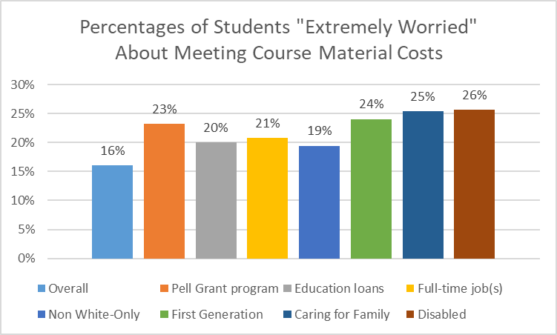
Worry about Course Material Costs
Each of the areas of concern had higher proportions of people who were “Extremely worried” about meeting their course materials costs than the overall group.

Slide 17
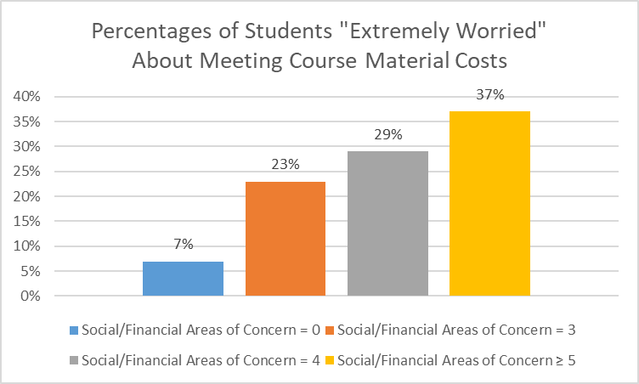
Worry about Course Material Costs
The effect on student worry grew with increasing numbers of the seven areas of concern identified. A First Generation, disabled student using Pell Grant funding, for example, would be more likely to be “Extremely Worried” about meeting course material costs than a student without any of the areas.

Slide 18
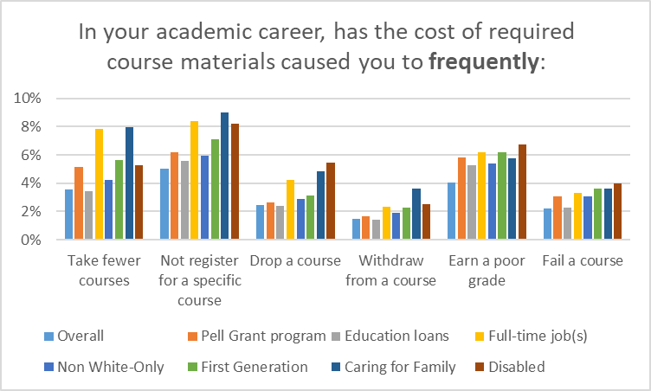
Academic Career Impact
Of chief concern are students who frequently had these issues. Students in the areas of concern consistently showed higher percentages in these areas than the overall population.

Slide 19
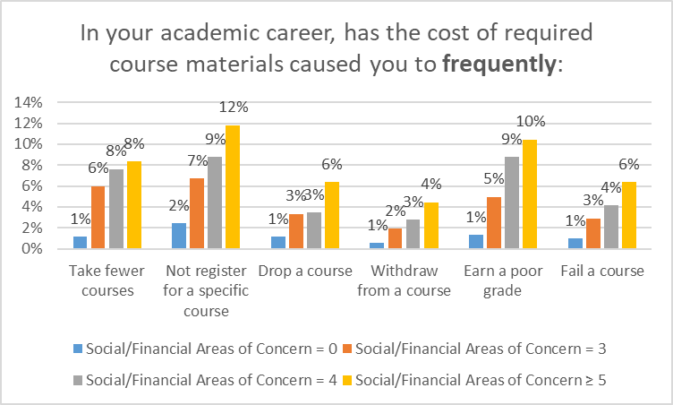
Academic Career Impact
The effect on academic career challenges grew with increasing numbers of the seven areas of concern identified.

Slide 20
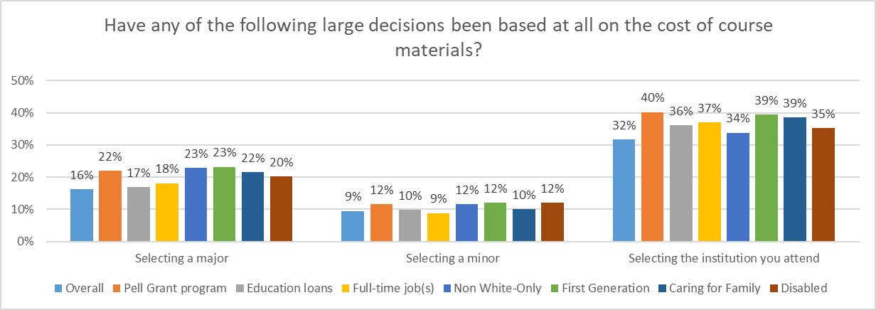
Impact on Large Decisions
The large decisions of major/minor/institution selection tended to have larger percentages of impact for students in areas of concern.

Slide 21
Examining Course Materials

Slide 22
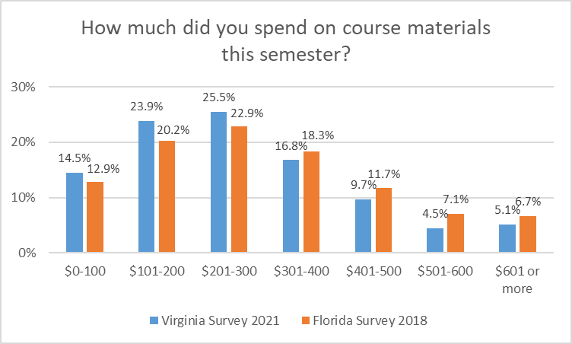
Course Materials Expenditures
The results for the course material expenditures were similar to the results of the 2018 Florida Student Textbook and Course Materials Survey (https://dlss.flvc.org/colleges-and-universities/research/textbooks).

Slide 23
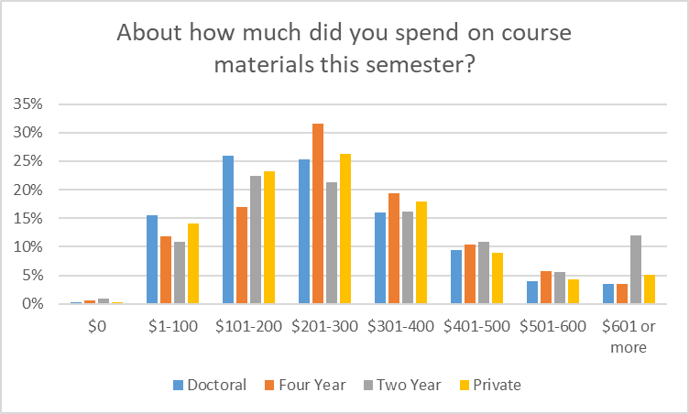
Course Materials Expenditures
A notable departure from the pattern was the large percentage of students at
two year institutions spending over $601 in the current semester.

Slide 24
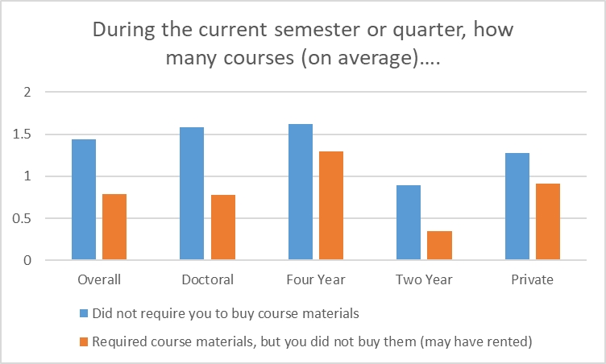
Required Materials
The number of courses in a given semester not requiring materials varied by institution type, as did trends in not buying (but possibly renting) required course materials.

Slide 25
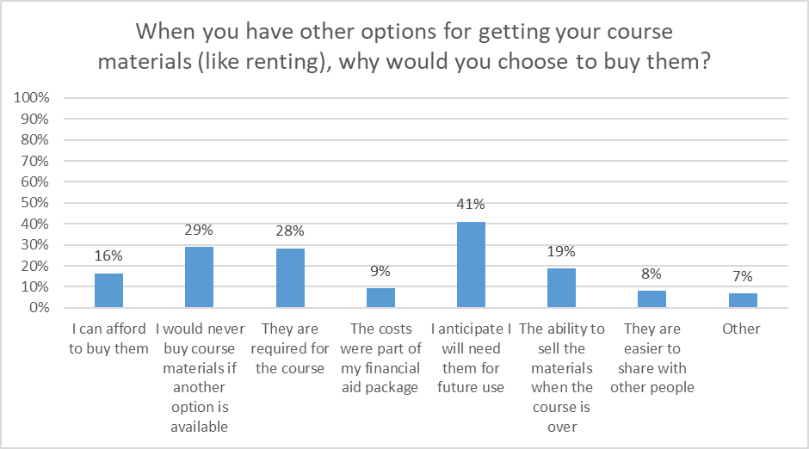
Course Materials Value
The most commonly cited reason to buy (rather than rent) course materials was anticipation of future use.

Slide 26
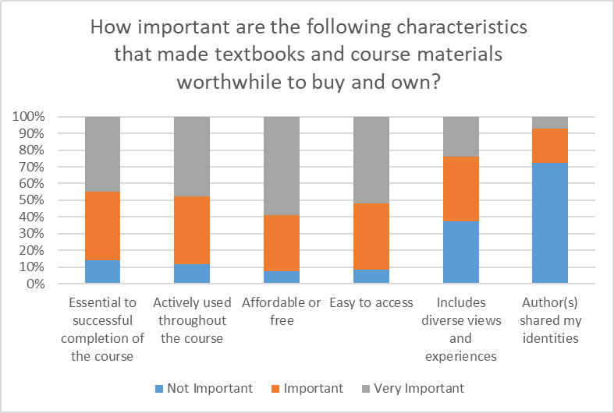
Course Materials Value
The most important characteristics that made course materials worthwhile to buy and own were that they were affordable/free, easy to access, actively used throughout the course, and essential to successful completion of the course.

Slide 27
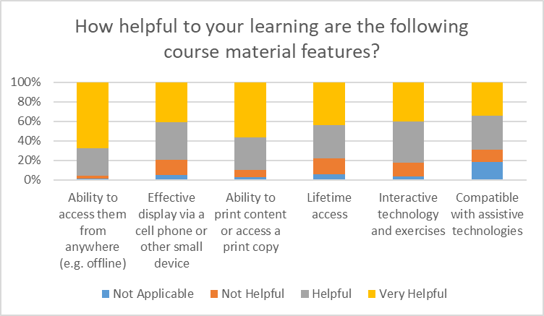
Course Materials Value
The most helpful aspects of course materials were the ability to access them from anywhere (e.g. offline) and the ability to obtain a print version.

Slide 28
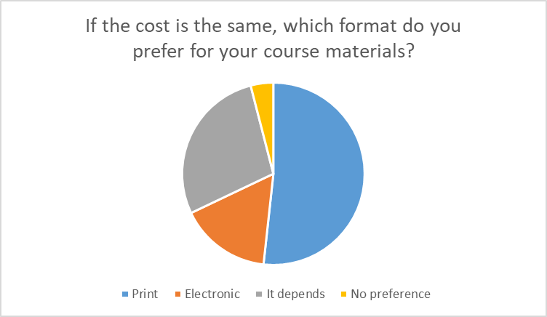
Print vs. Electronic
Slightly more than half of respondents preferred the print format for course materials, although over a quarter said that it depends.

Slide 29
Survey Demographics

Slide 30
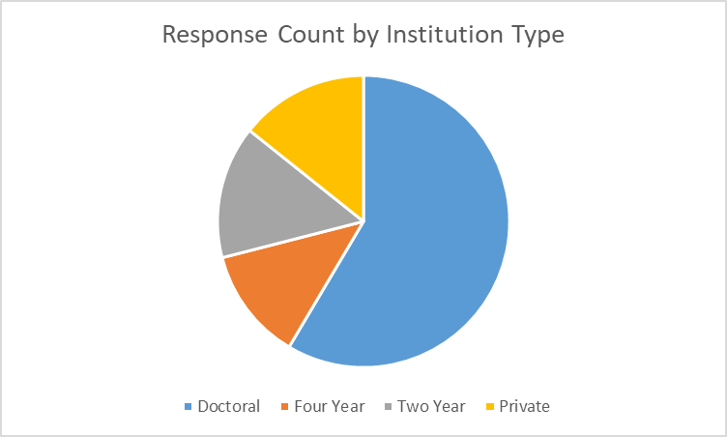
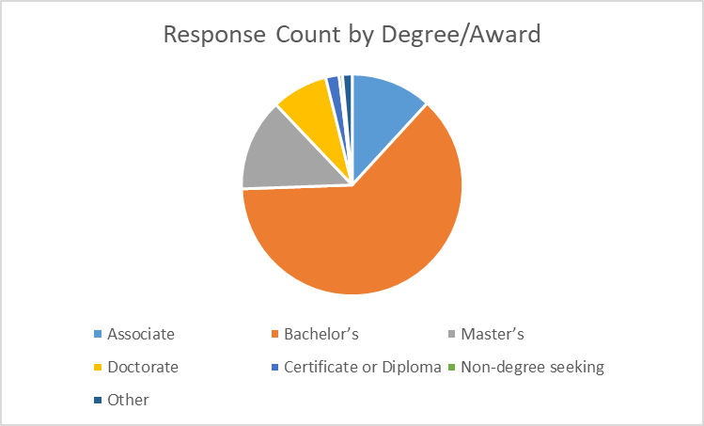
Response Descriptors
Many degree and award types were represented, with the largest response from students seeking Bachelor’s degrees.
All four VIVA institution types were represented, with the largest response from public doctoral institutions.

Slide 31
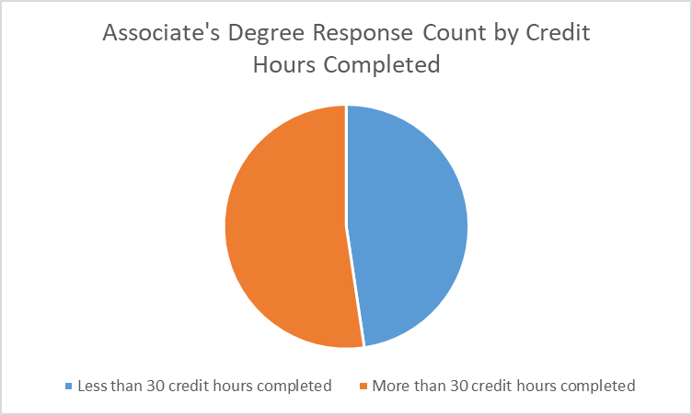
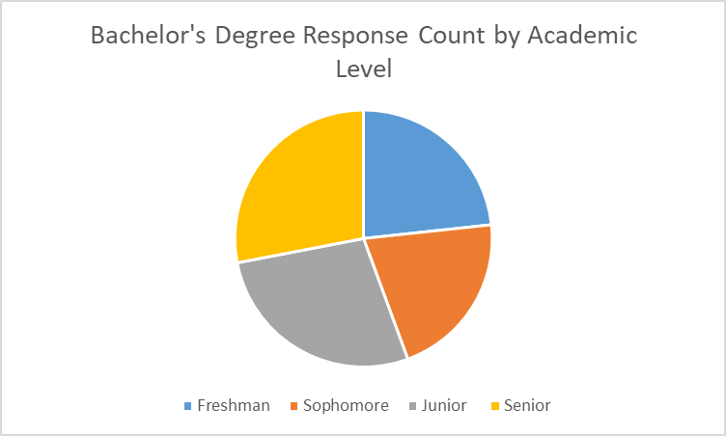
Response Descriptors
Students seeking Associate’s and Bachelor’s degrees were well-balanced by degree progress.

Slide 32
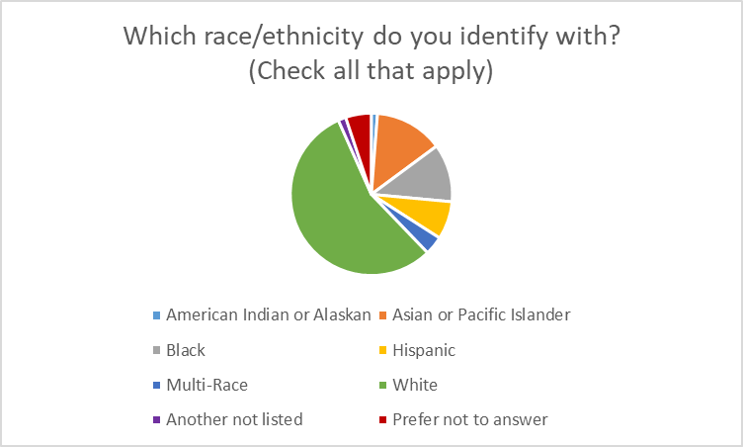
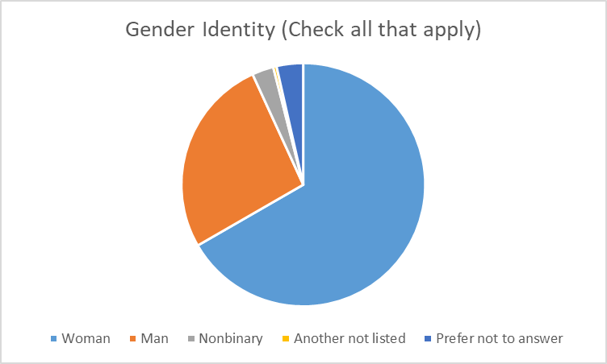
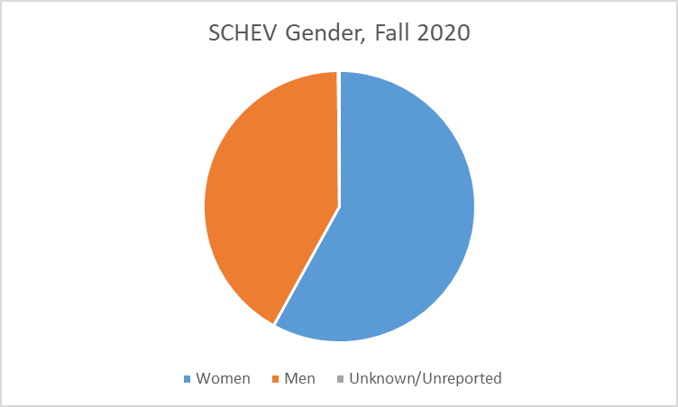
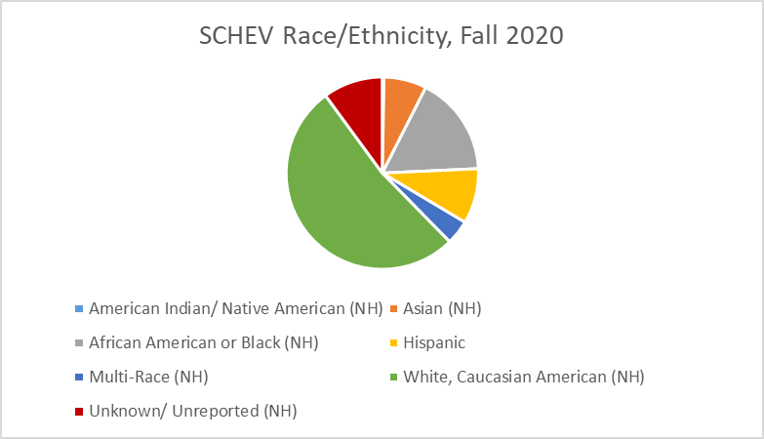
Response Descriptors
Race/ethnicity and gender identity reporting were similar to SCHEV/statewide population levels for higher education, with a strong response from respondents identifying as Women.

Slide 33
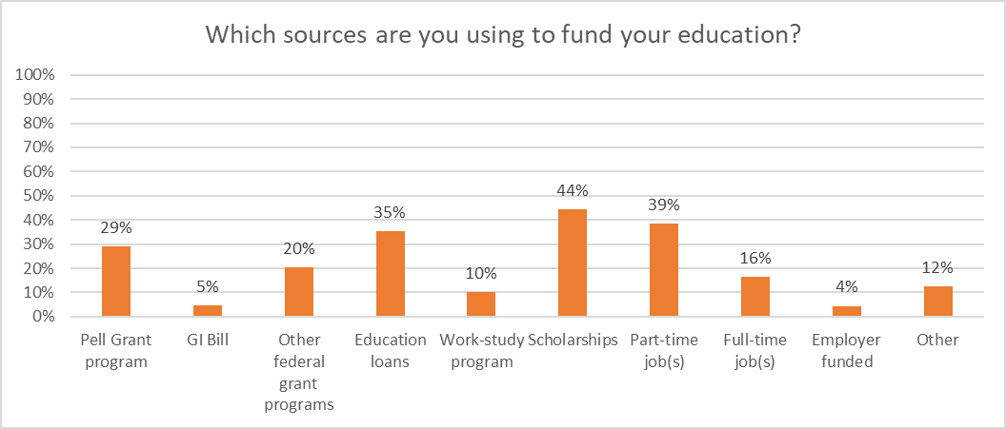
Funding Sources
The most common funding sources were scholarships, part-time job(s), and education loans.

Slide 34
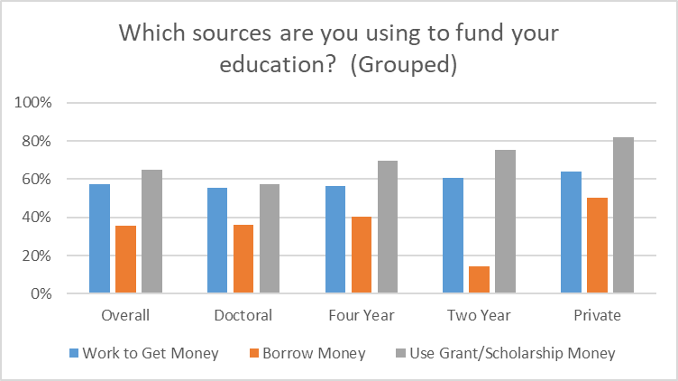
Funding Sources
Work to get money: Work study, PT job, FT job, Employer funded
Borrow money: Education loans
Use grant/scholarship money: Pell Grant, GI Bill, other federal grant programs, scholarships
Grouped funding sources varied by institution type.

Slide 35
Next Steps
This is intended to be a soft release of initial findings so that institutions can begin to discuss the local and statewide implications of the results.
A formal report is planned for Spring 2022.
If you have any questions, please contact viva@gmu.edu.

