Slide 1


Assessing Textbook Costs at Randolph College
Stephen Krueger
(he/him or they/them)
Access & Outreach Services Librarian
Lewis Ward
(he/him)
Museum & Heritage Studies/Studio Art, 2020
Notes:
STEPHEN: Greetings and salutations! I’m Stephen Krueger; my pronouns are he/him or they/them. I’m the Access & Outreach Services Librarian at Randolph College.

Slide 2
Outline
Randolph College and the Summer Research Program
Background
Methodology
Results
Limitations and future research
Questions (and possibly answers)
Notes:
Today, we’re going to tell you about a project that we did in which we researched the cost of textbooks at our college. We’ll briefly describe the school and the program that sponsored us. Then we’ll talk about the context for this type of research within libraries and some of the studies that we built our work upon. Then we’ll get into actually explaining our methodology and results. To wrap up, we’ll talk about limitations to the project and future research. We’ll have time for questions at the end, but you’re also welcome to ask them as they occur to you.

Slide 3
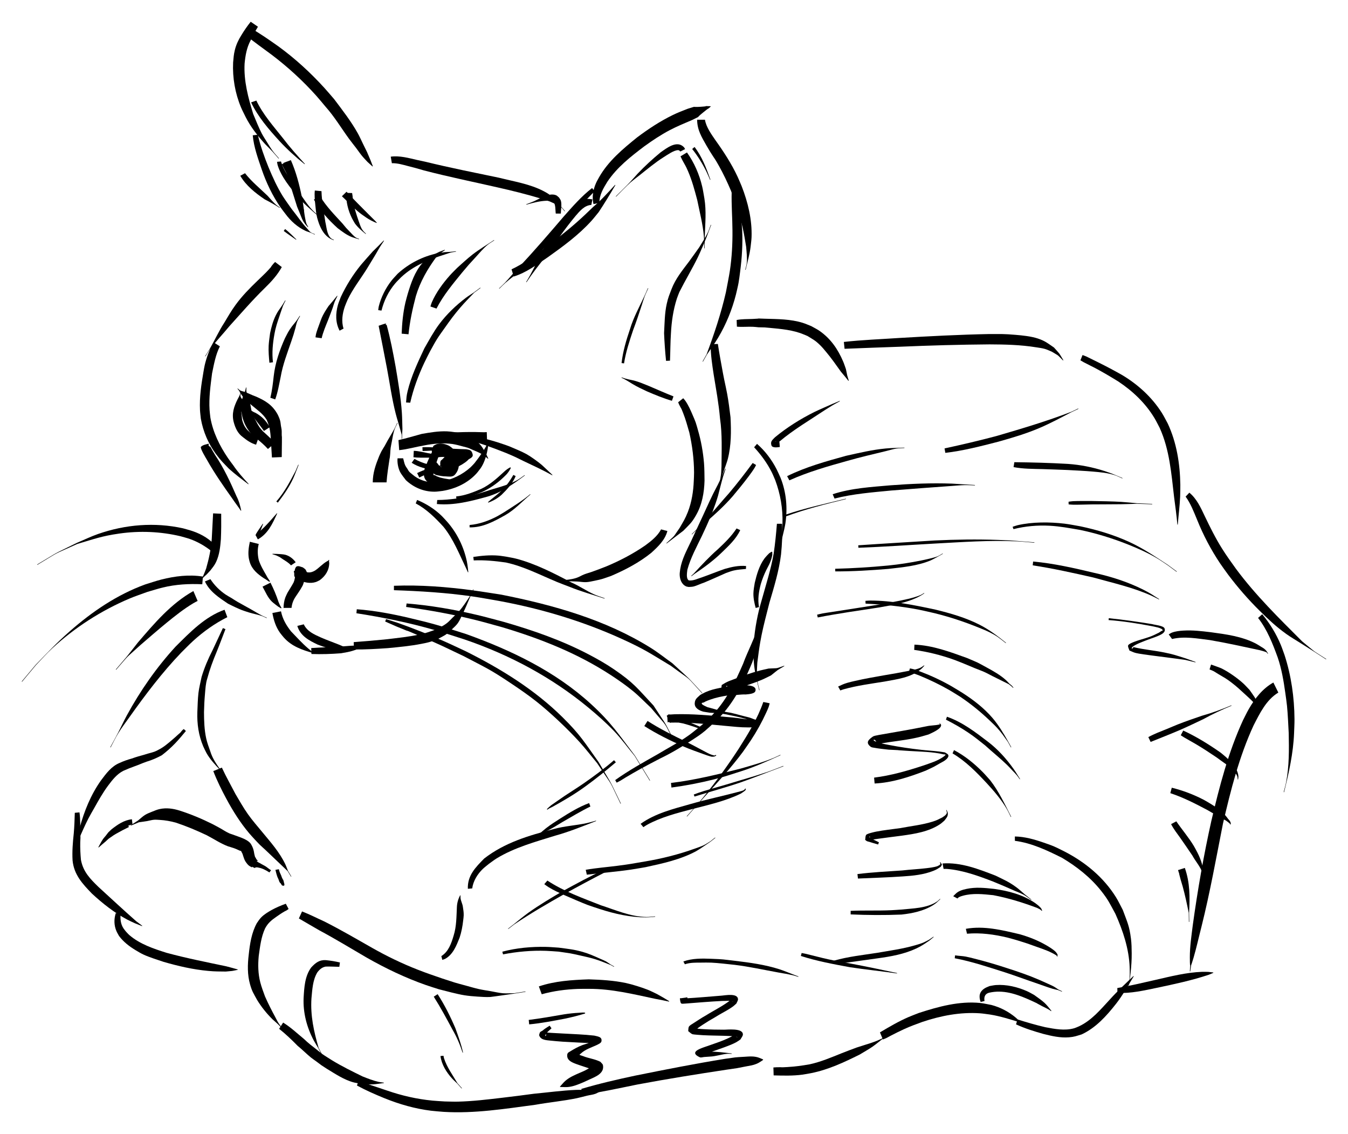
Randolph College
Private undergraduate liberal arts institution
Founded 1891 as Randolph-Macon Woman’s College
Went coed in 2007
~700 students
Notes:
STEPHEN: In order to give the project some context, I’m going to tell you a little bit about the school. Randolph is a private undergraduate liberal arts institution in central Virginia. It was founded in 1891 as Randolph-Macon Woman’s College and went coed in 2007. There are two small master’s programs, but the primary focus is on the 700 undergraduate students.
The history of the school actually ties into some of the reasoning behind the project. For decades, the student body was primarily white women with enough money to afford tuition. Recently, a lot of work has been done to diversify the student body, from going coed ten years ago to increasing the commuter student population (currently, about 25% of our students are local). The cost of attendance is obviously a huge factor influencing the makeup of the student body, so assessing textbook costs fit well with those efforts. This project was not popular with everyone on campus, but we did have a lot of interest and support from the Dean of the College and others who are working on making a Randolph education available to more people.

Slide 4


Summer Research Program
Student and Faculty Mentor-based Research Program
Began in 2000 with a grant from the Jessie Ball duPont Fund
Exists to fund student research from any discipline during an 8-week program
The program includes seminars from related disciplines of the students participating in hopes to stimulate interests in the other subjects involved.

Slide 5
Background
Published textbook costs: CollegeBoard, NACS
Studies: Florida Virtual Campus, others
Similar research: Open Oregon, VA community colleges, SPARC

Slide 6

Goals
Find accurate numbers for Randolph
Show cumulative costs for degrees
Encourage faculty to use OERs
Provide students with realistic expectations for different majors
Notes:
STEPHEN: We had several different goals in doing this research. I am the Open Textbook Network campus leader for Randolph College, which means that part of my work is to encourage and and assist faculty in adopting open educational resources. I wanted to start by assessing the current textbook costs at the school so that I would have concrete information to use when talking to faculty about the importance of minimizing those costs. We also wanted to learn about the differences between majors to find out which ones had the biggest cost barriers. This information could help students plan their finances with realistic expectations of the textbook costs over their four years of study. It could also give us somewhere to start when trying to lower textbook costs at Randolph. Another thought was that faculty, while not unaware of individual textbook prices, might not be thinking about the cumulative costs of a four-year degree. It carries a lot more weight to give a number for their major at their school than to throw around the national average, which can be easy to dismiss if they don’t think it reflects their area.

Slide 7

Scope
Highest and lowest costs for…
Each major
+ General Education courses
+ Electives
= All textbooks for all courses
Notes:
STEPHEN: We wanted to know the range of costs for a four-year degree in each major. As we could not calculate that without knowing the cost for each book in each course, that turned out to mean everything -- every book in every course offered by the school. We’re a small enough school that we did manage it, but it was not a small amount of information.

Slide 8

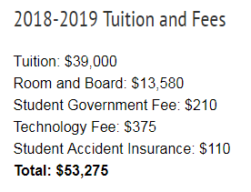
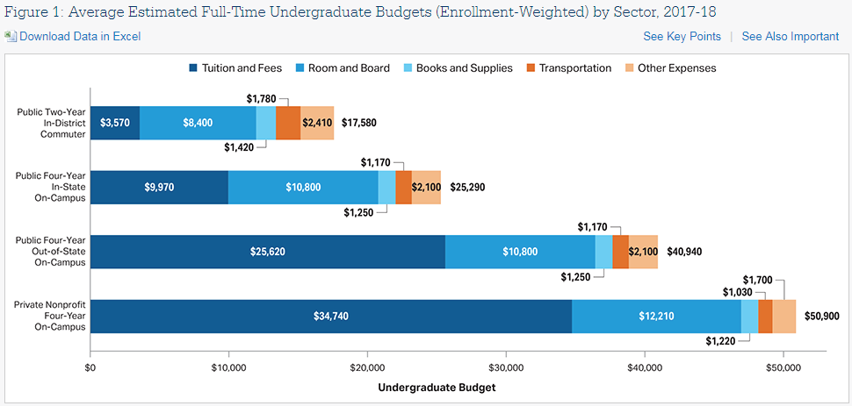
Current information
Randolph College, 2018
Randolph College, 2018
The College Board, 2018
Notes:
STEPHEN: The tuition and fees currently listed on the Randolph website have no number for textbook costs at all. A number for books and supplies is included in the financial aid letters that Randolph sends to admitted students, but it is just the figure drawn from the national average for colleges of our type published every year by CollegeBoard (most recently, this was $1,220 per year). We couldn’t definitively say that this wasn’t accurate, but the average is so generalized that we wanted more specific information to see how Randolph compared. The average number also provides no information about costs for different majors, which can vary widely.

Slide 9
Methodology
- Design Spreadsheets
- Record all classes available in the past 4 years
- Record each textbook and their cost, for each course
To be continued.
Notes:
Design spreadsheets, done with the help of Open Oregon’s similar project
Look up classes. All of them. Done by going through Randolph Course Catalog
Record textbook costs. All of them.
MBS (most)
MBS (least)
Amazon (lowestish)
Sort courses into Gen. Ed. categories
Create Gen. Ed. Schedules
Create major schedules
Calculate major costs (high and low)
Create total schedules
Total costs

Slide 10
- Sort courses into Gen. Ed. categories
- Create General Education Schedules
- Create Major Schedule
To be continued.
Notes:
Design spreadsheets, done with the help of Open Oregon’s similar project
Look up classes. All of them. Done by going through Randolph Course Catalog
Record textbook costs. All of them.
MBS (most)
MBS (least)
Amazon (lowestish)
Sort courses into Gen. Ed. categories
Create Gen. Ed. Schedules
Create major schedules
Calculate major costs (high and low)
Create total schedules
Total costs

Slide 11
- Calculate major costs ( high and low)
- Create total schedules
- Total costs
Notes:
Design spreadsheets, done with the help of Open Oregon’s similar project
Look up classes. All of them. Done by going through Randolph Course Catalog
Record textbook costs. All of them.
MBS (most)
MBS (least)
Amazon (lowestish)
Sort courses into Gen. Ed. categories
Create Gen. Ed. Schedules
Create major schedules
Calculate major costs (high and low)
Create total schedules
Total costs

Slide 12
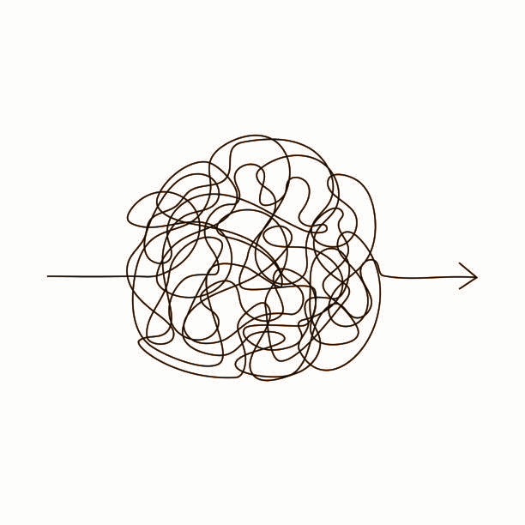
Results
It’s complicated.
Notes:
STEPHEN: When planning this project, I didn’t know what to expect as far as results. I did at least imagine that we would come up with some straightforward numbers that would be easy to share with our faculty and compare to the national averages. As it turned out, this was not to be that sort of project, which I suppose we could have anticipated if we’d really thought about it.

Slide 13

Results
Lowest cost (bookstore)
Lowestish cost (Amazon)
Highest cost
Average: $6,099.49 ($1,524.87 per year)
Range: $4,528.75 - $7,404.62
Average: $829.82 ($207.46 per year)
Range: $202.50 - $1883.75
Average: $369.75 ($92.44 per year)
Range: $85.99 - $1003.55
Notes:
STEPHEN: If we were to drastically oversimplify, these are some of the numbers that we might present. They come from averaging all of the majors within each type of cost bracket. For example, the average highest cost comes from taking the maximum cost of each major over four years, including the most expensive possible course selections for Gen Ed and elective credits, and averaging all of the majors together. This is somewhat more than the approximately $1,200/year number usually presented by the College Board, the number that Randolph tells students to expect to pay for their textbooks. The other averages are, as you see, much lower. To me, the most interesting numbers here are the ranges for each section; they are large enough that the averages are arguably meaningless. Note also that these are average possible costs; the major distribution of the student body is not part of this project, so these would not necessarily reflect what students are actually paying even if they were meaningful numbers.

Slide 14

Range
$85.99 - $7,404.62
Notes:
STEPHEN: So, what can we definitively report? Well, we know that students at Randolph are paying between $85.99 and $7,404.62 for their textbooks. This may seem just as useless as the averages we just presented, but this range does actually support one of our primary thoughts: between course selection and book purchasing choices, textbook prices vary so widely that an average number is probably not useful to faculty or students. It may be good information to have; schools can use the simplified numbers to compare their costs to other institutions, for one thing. It’s just not particularly telling for students wondering what they might realistically expect to spend.

Slide 15


Majors
Most expensive: Biology, Mathematics, Music, Business, Economics
Least expensive: Environmental Studies, Dance, Studio Art, Spanish
Notes:
STEPHEN: The most and least expensive majors varied based on which cost model we looked at, but there were some consistencies. The Biology degree was the only one that was always in the top five. Mathematics, Music, Business, and Economics were always in the top ten. On the other end, Environmental Studies was always in the five least expensive degrees; Dance, Studio Art, and Spanish were always in the bottom ten. Do note that this research did not take into account non-textbook costs, so courses with charges for supplies (such as art) may not be as affordable as they seem.

Slide 16
General Education & Electives
Gen Ed maximum cost: $2,910
Gen Ed minimum cost: $0
Elective maximum cost (average): $36.44 per credit hour
Elective minimum cost: $0
Notes:
STEPHEN: We determined that the maximum possible cost for all of the General Education requirements came to $2,910. That said, it was also possible to fill those requirements and spend nothing at all on textbooks. Similarly, elective courses could cost an average of $36.44 per credit hour ($109.32 per course), but one could also take only elective classes with no textbook costs. My main takeaway from these results is that it could help students to note low- or no-cost courses in the academic catalog; that way students can consider textbook costs when deciding between courses (this is another idea that came from an Open Oregon webinar; it is also being used and discussed at some community colleges in Virginia).

Slide 17
Limitations
Unlisted materials
Inconsistent Amazon prices
Wide range of course options
No realistic average
Faculty & students gone during summer

Slide 18
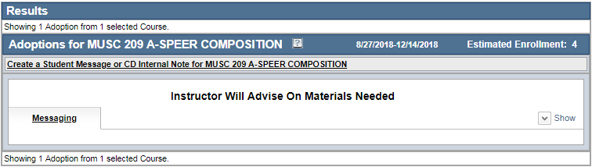
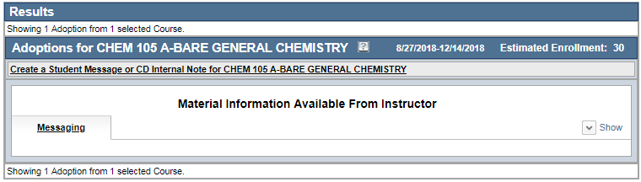
Limitations
Course Director: A Service of MBS Direct, n.d.

Slide 19
Future Research
Survey students
Survey professors
Interview students
Interview professors
Notes:
STEPHEN: As mentioned earlier, this project was only the first foray into the issue of textbook costs at Randolph. Now that we have concrete data on what students are being asked to spend, there are a number of avenues for future research. The one that makes the most sense to me as a next step is to find out what information did not turn up in this project. From talking to professors and from seeing those “materials available from instructor” notes on the bookstore website, we know that a number of people are already taking steps to minimize textbook costs; some are using OERs (though they don’t always realize it) and some are using past editions that the bookstore refuses to list. A comprehensive look into what professors are actually doing would be a very good next step. I’d also like to survey students in manner similar to the Florida Virtual Campus studies. Our research shows the costs assuming that students are actually buying the required resources, but that may not be the case. Other potential research might include live interviews of students and professors. Based on this project, I’m sure that every step will lead to more ideas for related work, so I’m going to stop there.

Slide 20
Thanks & Acknowledgments
Randolph College Center for Student Research
Open Oregon Educational Resources
The staff of Lipscomb Library
Tea

Slide 21
Resources
The College Board. (2018). Average Estimated Undergraduate Budgets, 2017-18. Retrieved from https://trends.collegeboard.org/college-pricing/figures-tables/average-estimated-undergraduate-budgets-2017-18
Course Director: A Service of MBS Direct. (n.d.) Randolph College Course Catalog. Retrieved from https://coursedirector.mbsdirect.net/cdr/index.php
Randolph College. (2018). Cost of attendance. Retrieved from http://www.randolphcollege.edu/admission/tuition/

Slide 22
Questions
????????
????????????
???? ?????
??? ?????
????
????
???
?????
?????
?????
?????

